Slide 1

1-1 LINE MANAGER-DIRECT REPORT MEETINGS IN COMPLEX, EMOTIONAL & RELATIONAL, HIGH-RISK WORK
BY PATRICK TOMLINSON (2024, REVISED, 2026)
www.patricktomlinson.com © Patrick Tomlinson, 2024, Revised 2026

Slide 2
CONTENTS
1. What is a 1-1 meeting?
2. Task performance and accountability
3. The value of a scheduled meeting in a protected space
4. Open and closed doors
5. Meeting Content
6. Engagement and presence
7. Focus on development
8. People management and leadership
www.patricktomlinson.com © Patrick Tomlinson, 2024, Revised 2026

Slide 3
CONTENTS
9. Issues to consider regarding time and frequency
10. Challenge, resistance, and ambivalence
11. Reflective questions and conclusions
12. Dr. Steven G. Rogelberg brief biography
13. References & Bibliography
www.patricktomlinson.com © Patrick Tomlinson, 2024, Revised 2026

Slide 4
THE PURPOSE OF THESE SLIDES IS TO PROVIDE INFORMATION & VIEWS ON THE POTENTIAL VALUE OF 1-1 MEETINGS.
SOME OF THE MATERIAL HAS AN EMPIRICAL BASE AND SOME IS OPINION BASED ON EXPERIENCE.
www.patricktomlinson.com © Patrick Tomlinson, 2024, Revised 2026

Slide 5
WHAT IS A 1-1 MEETING?

Slide 6
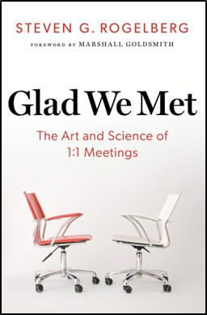
This definition by Rogelberg (2024, p.4) is a helpful starting point,
“In the simplest sense, 1:1s refer to a regular and recurring time held between a manager and their directs to discuss topics such as the direct’s well-being, motivation, productivity, roadblocks, priorities, clarity of roles/assignments, alignment with other work activities, goals, coordination with others/the team, employee development, and career planning.”

Slide 7

“One of the biggest values of the 1:1 is the ability to be frank with each other”. (Rogelberg, p.38)
To achieve this, a safe, protected, and reliable space is required. The scheduled 1-1 meeting in a suitable and confidential space is the ideal way of achieving a safe and productive working relationship.
PURPOSE

Slide 8
PURPOSE
“1:1s are the perfect opportunity to help others, give to others, and through both, experience the great intrinsic rewards of making a difference in the lives of others. When you have effective 1:1s, all lives are elevated—including your own.” (Rogelberg, p.11)

Slide 9
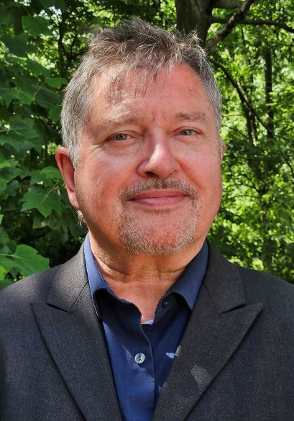
PURPOSE
Rogelberg makes the point that this is true of virtually all occupations. It is a human need to develop, improve, make a difference, and feel that one’s contribution matters. It is hard to think of any job where this would not be desirable. (Tomlinson, 2024a)

Slide 10

In his book on Personal and Professional Development, The Slight Edge, Jeff Olson (2013, p.101) argues that development and happiness are interconnected. The research on what it takes to raise happiness correlates closely to what it takes to improve personal development.
PURPOSE

Slide 11
We can see that the range of issues involved is complex. In any profession, working with people carrying out challenging tasks can be complex on professional and personal levels. Therefore, carrying out effective 1-1 meetings crystalizes the difficulties involved. People skills as well as technical knowledge are important.
NECESSARY SKILLS

Slide 12
NECESSARY SKILLS
All work between people has a relational element and requires a degree of emotional intelligence. For example, attunement to feelings, empathy, and compassion. There must also be cultural sensitivity to help avoid misunderstandings. Also, to be attuned to the way that power dynamics, bias, and discrimination can enter the meeting process and relationship.

Slide 13
TRAUMA-INFORMED
In some fields of work, such as therapeutic services for traumatized children the primary task of the work is essentially relational. This means that a high level of relational skills is especially important. As trauma is central to the work; understanding the nature of trauma, how it might be manifested, and how to respond is vital.

Slide 14
TRAUMA-INFORMED
Weekly 1-1 meetings, whether with a line manager, consultant, or mentor, will significantly improve the likelihood that signs of vicarious trauma and burnout are picked up early. 1-1 meetings in this context must be trauma-informed and effective in the way these issues are responded to.

Slide 15

“Thinking and pausing, rather than reacting, is vital in all types of roles and professions. In trauma-informed services, it is vital. In trauma work, the tendency towards reactivity is so high, unhelpful, and potentially retraumatizing. The same can be said of any work that involves crisis and high levels of stress.” (Tomlinson, 2024a)
PAUSING AND THINKING

Slide 16
TASK PERFORMANCE & ACCOUNTABILITY

Slide 17
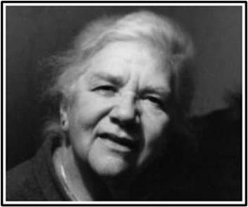
The organizational consultant, Isabel Menzies Lyth (1979, p.222), explains the meaning of the manager’s role concerning staff support and the primary task,
“Rice (1963) has said that the effective performance of a primary task is a major source of satisfaction and that insofar as behaviour is adult and reality-based people are loath to surrender such satisfaction…
TASK PERFORMANCE & ACCOUNTABILITY

Slide 18
… The responsibility of management for effective task-performance is a contribution to staff support, both through positive job satisfaction and through protecting staff from the anxiety, guilt and depression that arise from inadequate task-performance.”
Therefore, it is supportive to focus on what is needed to do a job well. The word support has become a bit at odds with the concept of accountability.
TASK PERFORMANCE & ACCOUNTABILITY

Slide 19

Therefore, it is supportive to focus on what is needed to do a job well. The word support has become a bit at odds with the concept of accountability. I tend to agree with the point made by Brené Brown (2018) that,
“Clear is kind. Unclear is unkind… Not getting clear with a colleague about your expectations because it feels too hard, yet holding them accountable or blaming them for not delivering is unkind.”
TASK PERFORMANCE & ACCOUNTABILITY

Slide 20
Rogelberg (p. 110) argues,
“Accountability and kindness are not mutually exclusive in any way. Sometimes, holding people accountable is an act of kindness in and of itself. Overall, being kind is essential to addressing personal needs and building a robust relationship...
TASK PERFORMANCE & ACCOUNTABILITY

Slide 21
… It also allows your messages of accountability and/or critical feedback to be more readily heard, as you intend them as kindness can break down walls of defensiveness and close-mindedness. It is also noteworthy that kindness begets kindness.”
TASK PERFORMANCE & ACCOUNTABILITY

Slide 22

Referring to decades of research, Gallup (2024, p.19) agrees about the importance of accountability,
“Managers drive engagement through goal setting, regular, meaningful feedback and accountability. Gallup’s decades of research into effective management finds that a great manager builds an ongoing relationship with an employee grounded in respect, positivity, and an understanding of the employee’s unique gifts…
TASK PERFORMANCE & ACCOUNTABILITY

Slide 23
… Great managers help employees find meaning and reward in their work. As a result, employees take an interest in what they do, leading to higher productivity and enjoyment.”
TASK PERFORMANCE & ACCOUNTABILITY

Slide 24
THE VALUE OF SCHEDULED MEETINGS
IN A SAFE PROTECTED SPACE

Slide 25
Passing conversations, catch-ups, and updates by nature are not usually deep. Neither is it possible to deal with complex and emotional issues where the consequences are potentially high.
(Tomlinson, 2024a)
THE VALUE OF SCHEDULED MEETINGS IN A SAFE PROTECTED SPACE

Slide 26
“It is also human nature to avoid pain and deny difficulties. A more casual way of working feeds into these defensive avoidances. Sometimes we are not aware of something troubling until we sit down in a safe space with an attentive other.” (Tomlinson, 2024a)
THE VALUE OF SCHEDULED MEETINGS IN A SAFE PROTECTED SPACE

Slide 27
THE VALUE OF SCHEDULED MEETINGS IN A SAFE PROTECTED SPACE
“If we do not at least regularly pay attention to what is going on in our work and life, there is a serious risk that unacknowledged issues either get acted out towards others or cause internal pain, physically and mentally.” (Tomlinson, 2024a)

Slide 28
THE VALUE OF SCHEDULED MEETINGS IN A SAFE PROTECTED SPACE
“A lack of opportunity to acknowledge, think about, and try to understand difficulties in challenging work is a major cause of staff sickness, absence, and turnover, among other significant organizational symptoms.” (Tomlinson, 2024a)

Slide 29
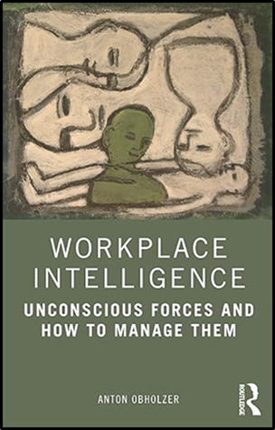
“Having a specific time set aside on a regular basis to meet with staff in relation to their work roles is essential. If this is respected by both sides, it opens successful channels of communication. But here, too, there are pitfalls. Constant interruption, taking telephone calls, looking at the computer screen rather than the individual concerned, reading and sending texts, all give a clear message:
WHY THE SCHEDULED PROTECTED SPACE IS SO IMPORTANT TO PROVIDE GOOD QUALITY ATTENTION

Slide 30
… ‘I cannot really be bothered to give you my full attention’. Behaving in this manner encourages others to do the same: ‘If the boss can behave in this way, then it must also be acceptable for me’. This creates a climate of pseudo-attention and pseudo-communication that is likely to ‘infect’ the entire organization. What is not a good model for family and couple communication is certainly not a good model in institutional practice.” (Obholzer, p.135)
WHY THE SCHEDULED PROTECTED SPACE IS SO IMPORTANT TO PROVIDE GOOD QUALITY ATTENTION

Slide 31
OPEN AND CLOSED DOORS

Slide 32

OPEN AND CLOSED DOORS
Sometimes, when line managers are asked why they do not have more frequent scheduled meetings, the answer given is that ‘we check in with each other regularly’. Phrases like my door is always open, and I’m approachable, etc., …

Slide 33
OPEN AND CLOSED DOORS
… are often used as if a scheduled meeting with a pre-planned agenda is the same as a check-in. The two things are connected but quite distinct. Ad hoc conversations in the daily course of work can complement 1-1s but not substitute for them.

Slide 34
OPEN AND CLOSED DOORS
Being approachable and finding time for team members differs from a focused, prepared, scheduled meeting. The thinking processes for each are different. For instance, catching someone unprepared and raising a challenging issue might be unfair and unhelpful.

Slide 35
OPEN AND CLOSED DOORS
… A safe working relationship is established by openness and putting the necessary conditions in place to ensure the reliable safety of a protected time and space. The space must be protected from distractions.

Slide 36
Anton Obholzer (2021, p.134) on “in-house staff support systems”,
“These take a variety of forms. The worst form, in my view, is captured by the phrase, ‘my door is always open’. This is meant to show that the person concerned is always available for, and open to, contact with members of the organization…
OPEN AND CLOSED DOORS

Slide 37
… It may be so, but this, in itself, raises the question of what sort of management and/or leadership can be achieved when the individual is constantly available for interruption. While sounding open and friendly, it can actually have the opposite effect…
OPEN AND CLOSED DOORS

Slide 38
… One could interpret this dynamic as: ‘I cannot bother to set aside a regular time to meet with you, but if you can find your way through the obstacle course we might meet’. This process of contact is not conducive to good communication.”
OPEN AND CLOSED DOORS

Slide 39
“Interestingly, Obholzer picks out the ‘my door is always open’ as being the worst form of espoused staff support. Maybe the use of the term just means being friendly, responsive, and approachable. But it is misleading. A door always being open can communicate the wrong message. It suggests that the person is always available and even invites regular disruption.”
(Tomlinson, 2024a)
OPEN AND CLOSED DOORS

Slide 40
“It also suggests a lack of appropriate boundaries, which may undermine the development of oneself and others. Constant availability is not good for mature development. Development is often helped by having to work something out on one’s own and managing to wait.” (Tomlinson, 2024a)
OPEN AND CLOSED DOORS

Slide 41
MEETING CONTENT

Slide 42
“The most important criterion governing matters to be talked about is that they be issues that preoccupy and nag the subordinate. (Andy Grove, Former CEO and Co-Founder, Intel).” (Rogelberg, p.59)
“… the data suggest that agendas are helpful, but do not need to be detailed or highly structured for 1:1s to be effective.” (Rogelberg, p.59)
MEETING CONTENT

Slide 43
“Content also includes the quality of the attention and experience. Making a commitment to the meeting and arriving well prepared and on time gives the right kind of message. The way the meeting is conducted must reflect organizational values that are respectful, etc. As part of the meeting process, there should be a personal element.” (Tomlinson, 2024a)
MEETING CONTENT

Slide 44
“Tacy Byham’s (2015) work does such a great job of highlighting the two types of needs to be fulfilled in a successful 1:1 process. Namely, an excellent 1:1 process addresses directs’ practical and personal needs.” (Rogelberg, p.92)
MEETING CONTENT

Slide 45
“Satisfying Personal Needs Is Critical. While 1:1s are meant to address the direct report’s practical needs, they must also be conducted in a way that meets their personal needs. Doing so ensures that directs feel included, respected, valued, heard, understood, and supported.” (Tomlinson, 2024a)
MEETING CONTENT

Slide 46
“A key piece of a 1:1 is truly to get to know your direct, what is their personal story, and of great relevance, what drives them. This allows you to truly connect with your people. This connection is so important.” (Rogelberg, p.60)
MEETING CONTENT

Slide 47
“An important aspect to be observant of and discuss is the relational dynamic between the manager and direct report. As there are matters of authority involved, it is always possible that powerful primitive feelings can arise in the relationship. This is especially so when the work is, by nature, complex, emotional, relational, and high-risk.” (Tomlinson, 2024a)
RELATIONAL DYNAMICS

Slide 48
“If the relational matters are reflected upon effectively, useful insights can be gained. If they are not, the relationship may be at risk of becoming ineffective, with negative consequences being acted out.” (Tomlinson, 2024a)
RELATIONAL DYNAMICS

Slide 49
ENGAGEMENT AND PRESENCE

Slide 50
The quality of attention, psychological presence, and engagement are especially important. In general, presence is a key element of effective leadership (Kahn, 1990, 1992; Friedman 1999). Friedman has referred to this as a non-anxious, self-differentiated presence, where the person can be connected and involved but also separate. This offers a containing and thoughtful space for difficult and powerful issues to be made sense of.
ENGAGEMENT AND PRESENCE

Slide 51
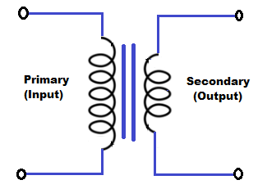
Friedman (1999, p.232) has also referred to the process of containment by using the transformer in an electrical circuit as a metaphor. The issue (anxiety) might enter the space (meeting) at 1000 volts and, through the transformative process, leave at 100 volts. Or it could be the other way around. The manager in the meeting is responsible for the role of a transformer. However, where the senior person’s presence is not in good shape, it can easily go the other way. This is why self-management and self-awareness are so important to effective management and leadership.
A CONTAINING TRANSFORMER

Slide 52
“To the extent that leaders and consultants can maintain a non-anxious presence in a highly energized anxiety field, they can have the same effects on that field that transformers have in an electrical circuit.” (Friedman, 1999, p.232)
A CONTAINING TRANSFORMER

Slide 53
The international research across all industries by Gallup (2024) confirms that employee engagement is the key influence on individual and organizational performance. Gallup provides analytics and management consulting to organizations globally. Their global reports feature “annual findings from the world’s largest ongoing study of the employee experience. We examine how employees feel about their work and their lives, an important predictor of organizational resilience and performance”.
ENGAGEMENT AND PRESENCE

Slide 54
Not surprisingly, their research has found that the key issue affecting performance is employee engagement. Employee engagement is strongly associated with manager engagement. Gallup (2024, p.2) has found that 70% of all variances in team employee engagement correlate with the level of manager engagement. That is of major significance both for the quality of management in general and for the 1-1 meeting process. The need to engage and develop managers cannot be underestimated.
ENGAGEMENT AND PRESENCE

Slide 55
If the manager is not engaged, the meeting process is not likely to help the direct report and may even have a negative impact. Gallup has studied the engagement levels of 2.5 million manager-led teams around the world and found that, on average, only 15% of employees who work for a manager who does not meet with them regularly are engaged; managers who regularly meet with their employees almost triple that level of engagement (in Rogelberg, p. 8).
ENGAGEMENT AND PRESENCE

Slide 56
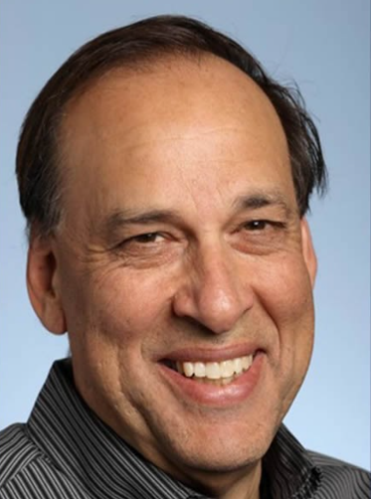
“Personal engagement is the simultaneous employment and expression of a person’s “preferred self” in task behaviors that promote connections to work and to others, personal presence (physical, cognitive, and emotional), and active, full role performances. My premise is that people have dimensions of themselves that, given appropriate conditions, they prefer to use and express in the course of role performances.” (1990, p.700)
ENGAGEMENT AND PRESENCE

Slide 57
“I defined personal disengagement as the uncoupling of selves from work roles; in disengagement, people withdraw and defend themselves physically, cognitively, or emotionally during role performances…
ENGAGEMENT AND PRESENCE

Slide 58
… The personal engagement and disengagement concepts developed here integrate the idea that people need both self-expression and self-employment in their work lives as a matter of course (Alderfer, 1972; Maslow, 1954).” (1990, p.700)
ENGAGEMENT AND PRESENCE

Slide 59
Kahn (1992) expanded upon the importance of psychological presence as a key part of engagement in, To Be Fully There: Psychological Presence at Work. Referring to Kahn’s work, Cardona (2003) claimed with the title of her paper,
The Manager's Most Precious Skill: The Capacity to be `Psychologically Present’
ENGAGEMENT AND PRESENCE

Slide 60
“In all fields of work and especially in trauma services, the attuned attention of a manager is a great benefit to optimizing the performance and development of their direct reports. It can also have indirect knock-on benefits to others. It helps create non-anxious, self-regulation, and the capacity to think.” (Tomlinson, 2024)
ENGAGEMENT AND PRESENCE

Slide 61
In these conditions, the worker will be more likely to reflect ‘on action’ and ‘in action’ (Schön, 1983). It is likely to have a great impact on improving responsiveness and reducing reactiveness. People are more likely to feel safe enough to,
“Employ the self without the fear of negative consequences.” (Khan, 1992, p. 333).
ENGAGEMENT AND PRESENCE

Slide 62
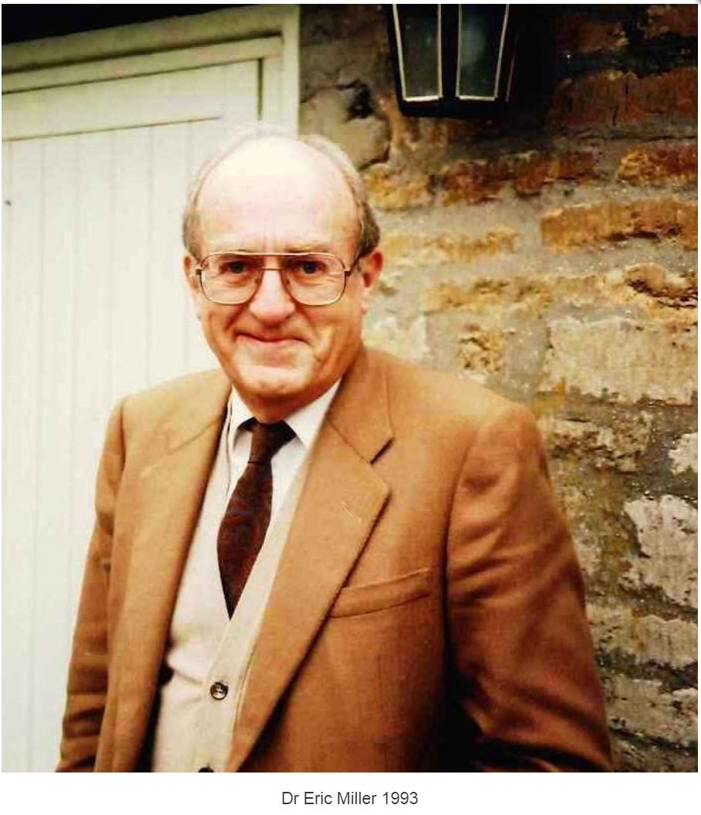
Another useful way of thinking is to consider the manager as a model for what is expected of the direct report in the delivery of their work. Miller (1993) explains this well and makes these two key points,
1. The quality of the holding environment of staff is the main determinant of the quality of the holding environment that they can provide for clients.
2. The quality of the holding environment of staff is mainly created by the form of organization and by the process of management.
ENGAGEMENT AND PRESENCE

Slide 63
“Everything that goes on in the meeting also provides a model for what is likely to go on outside of it. For example, if a direct report feels listened to, valued, and treated with respect, they are more likely to mirror those qualities with others.” (Tomlinson, 2024a)
ENGAGEMENT AND PRESENCE

Slide 64
“There are few opportunities better than a 1-1 meeting to model appropriate boundaries, clarity of purpose, reliability, attentiveness, and the balance between seriousness and lightness, among many other important qualities.”
(Tomlinson, 2024)
ENGAGEMENT AND PRESENCE

Slide 65
FOCUS ON DEVELOPMENT

Slide 66
“For a 1-1 meeting process to be effective, there needs to be a focus on development. Inevitably, there will be a need for problem-solving and going over significant events, but these discussions can also include a focus on what we have learned…
FOCUS ON DEVELOPMENT

Slide 67
… How has an experience given insight that can be used in the future? What further work can we do to understand the issue better? In the modern-day workplace, we must not underestimate the importance of professional and personal development. This is at the top of Maslow’s (1943) hierarchy of needs – self-actualization.” (Tomlinson, 2024a)
FOCUS ON DEVELOPMENT

Slide 68
“1:1s are the perfect opportunity to help others, give to others, and through both, experience the great intrinsic rewards of making a difference in the lives of others. When you have effective 1:1s, all lives are elevated—including your own…
FOCUS ON DEVELOPMENT

Slide 69
… The general assumption is that 1:1s are not for those who, say, work with their hands and use their physical abilities to complete their work (e.g., blue-collar, pink-collar, and working-class type jobs), such as construction workers, mechanics, custodial workers, truck drivers, nurses, and machine operators. I don’t fully understand why anyone would feel this way…
FOCUS ON DEVELOPMENT

Slide 70
… The desire to thrive, overcome obstacles, develop meaningful relationships, and feel seen/heard is not unique to any particular job type or profession.” (Rogelberg, p.11)
FOCUS ON DEVELOPMENT

Slide 71
“Development is so important to human nature that if we do not work on it effectively, there is a likelihood of disengagement. To help keep a focus on development, all information that can be shared outside of the meeting must be done efficiently through emails, data systems, and other updates…
FOCUS ON DEVELOPMENT

Slide 72
… It is not helpful to use the meeting to track metrics, but rather to be informed in advance of where things are at. Discussion should focus on growth, development, and solutions. As this can be challenging work, we cannot always expect the discussion to flow easily.”
(Tomlinson, 2024a)
FOCUS ON DEVELOPMENT

Slide 73

“Get comfortable with silence as a manager. It can be tempting to want to fill the silence if and when it happens, but keep in mind that silence is often an indication of contemplation rather than awkwardness or a lack of engagement. You can even encourage moments of silence by telling your directs to pause whenever they need to so they can think through their ideas. This does not have to be a rushed process.” (Rogelberg, p. 119)
FOCUS ON DEVELOPMENT

Slide 74
PEOPLE MANAGEMENT & LEADERSHIP

Slide 75
Often, a leader does not prioritize the development of their team and direct reports. For example, in response to the question, ‘Why don’t you have more frequent 1-1 meetings?’ the answer might be, ‘I don’t have enough time’. Rogelberg (p.4) argues against the misguided nature of this,
“1:1s are a core leadership responsibility. The best leaders recognize that 1:1s are not an add-on to the job; 1:1s ARE the job of a leader.”
PEOPLE MANAGEMENT & LEADERSHIP

Slide 76
While there may be exceptions to this, I agree with his point. Effective 1-1 as well as team meetings can boost development and quality of performance. Rogelberg (p.7) claims that this is strongly supported by research and that,
“1:1s are arguably one of the most important activities you can do as a leader.”
So, this should save time by reducing the number of problems arising due to errors, mistakes, and poor work.
PEOPLE MANAGEMENT & LEADERSHIP

Slide 77
ISSUES TO CONSIDER REGARDING TIME
& FREQUENCY

Slide 78
These are helpful questions to ask when considering time and frequency,
1. How complex is the work task? (i.e., if it is working with young people who are in care, having suffered complex trauma, the work is highly complex).
2. How much are emotional issues part of the work? Some work is highly emotional and some so little that you can be fairly switched off, though those kinds of jobs are less common than they were.
ISSUES TO CONSIDER REGARDING TIME & FREQUENCY

Slide 79
3. How serious are the potential consequences of not doing the job well or making a mistake? In some jobs, the consequences can be a matter of life and death, and in others, small.
4. How experienced is the worker and competent from technical and self-management perspectives? Less experienced workers may need more frequent meetings.
5. How important are relationships in the work task? In some work, the relational context, safety, and trust can outweigh the technical abilities. In others, technical skill and experience are paramount. A higher frequency will be needed in a new manager-direct report relationship to help build the relationship.
ISSUES TO CONSIDER REGARDING TIME & FREQUENCY

Slide 80
Rogelberg’s (p. xix) research found that across all industries, the more frequent the 1-1s, up to weekly compared with fortnightly or monthly, the better the outcomes in engagement and performance. In a study of 200 managers, the frequency was found to be: Weekly 49%. Bi-weekly 22%. Monthly 15%. Quarterly 2% (p.23). Rogelberg found that on average, weekly 1-1s correlated with the highest level of performance. To conclude (p.24), he states,
“Weekly 1:1s aligns most with employee preferences in general across job level and country.”

Slide 81

O.C. Tanner is the global leader in software and services that improve workplace culture through meaningful employee experiences. Their research (2021, p.35-36) found remarkably similar results to Rogelberg in the correlation between meeting frequency and performance.
THE CORRELATION BETWEEN MEETING FREQUENCY & PERFORMANCE

Slide 82

O.C. Tanner synthesized multiple research studies involving more than 40,000 employees and leaders from 20 countries. This research showed a statistically significant difference in the effectiveness of one-to-ones held weekly versus every other week (biweekly) and monthly. The results are captured below,
THE CORRELATION BETWEEN MEETING FREQUENCY & PERFORMANCE

Slide 83
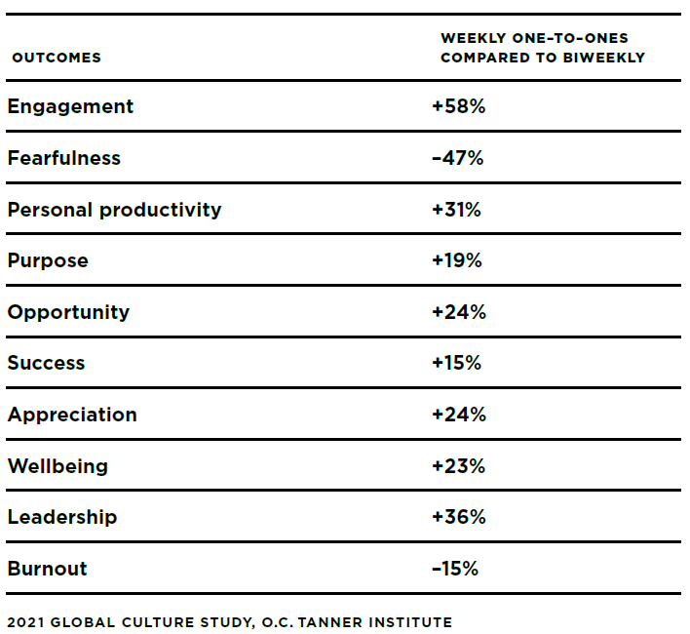

Slide 84

Every metric is improved. Engagement is up by 58%, and fearfulness is down by 47%. This research was carried out following the pandemic, when working from home was the new norm. Greater employee isolation was one of the consequences.
THE CORRELATION BETWEEN MEETING FREQUENCY & PERFORMANCE

Slide 85

Engagement and fearfulness are hugely relevant to performance quality and other important matters such as well-being and burnout. O.C. Tanner argues that the nature of work has changed, and organizational leadership and culture must adapt. Attention must be paid to this, especially in occupations that are challenging, stressful, and relatively isolating. Improving meeting frequency and quality is a key factor.
Organizational Resilience

Slide 86
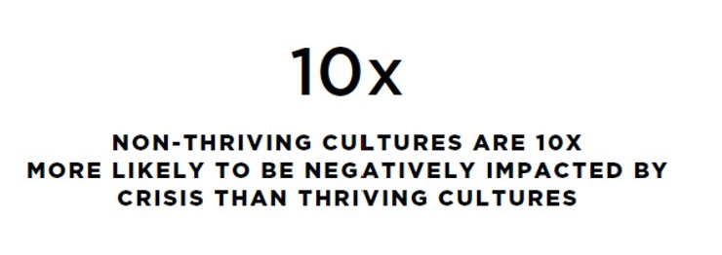
Just to re-iterate that crucial claim from O.C. Tanner
Organizational Resilience

Slide 87
As well as the frequency of meetings, the length of each meeting is also important. Does a meeting need 30 minutes, an hour, or longer? One consideration may be to do with the time needed for in-depth discussion and processing of complex issues.
If meetings are more frequent, weekly, for instance, one meeting could be for 1 hour and the other for 30 minutes. The tasks of the different meetings could be differentiated. One person I work with has found it helpful to alternate between a more strategic and a more reflective type of meeting. Or it could be a more problem-solving and a more development-focused meeting.
HOW LONG SHOULD THE MEETING BE?

Slide 88
The balance of frequency is important. Obholzer (p.125) reminds us that,
“… what happens between formal sessions is at least as important as what happens in the sessions themselves. This time provides the space to think about matters raised and to see whether ideas considered in the sessions are relevant to everyday life. Perhaps most importantly, do they offer a more constructive way for life and work?”
THE BALANCE OF FREQUENCY

Slide 89
CHALLENGE. RESISTANCE. & AMBIVALENCE

Slide 90
As frequent 1-1 meetings are essential for growth, development, effectiveness, and achievement at all levels from individual to organization, we might wonder why valuing them is not more predominant and why the resistance can be so strong. These are some of the possible reasons.
1. Some professionals and managers may not be aware or may be skeptical of the rationale behind 1-1 meetings and the evidence that underpins it.
2. Some people may think there is no need for regular meetings as they are doing well enough.
CHALLENGE. RESISTANCE. & AMBIVALENCE

Slide 91
The reality of doing well enough may be true to some extent, but it could also be a defence against a more challenging reality. Eurich (2018) claims,
“In our nearly five-year research program on the subject, we’ve discovered that although 95% of people think they’re self-aware, only 10 to 15% are.”
3. Spending time thinking in meetings can feel like it is not a priority.
Thiel et al. (2012) argue that the consequences of not taking time to reflect can result in sub-optimization of leadership actions and decisions, which may lead to poor judgment and even ethical lapses. They claim,
“Thus, setting aside time and space to think could be considered a leadership imperative.”
CHALLENGE. RESISTANCE. & AMBIVALENCE

Slide 92
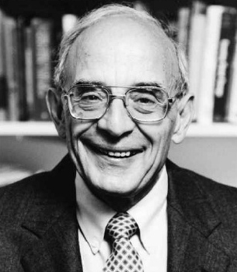
4. Learning is challenging and never-ending, though the rewards of being a life-long learner are great.
Chris Argyris (1991) claims that it can be people at the top of an organization who find it the hardest to learn.
CHALLENGE. RESISTANCE. & AMBIVALENCE

Slide 93
“Put simply, because many professionals are almost always successful at what they do, they rarely experience failure. And because they have rarely failed, they have never learned how to learn from failure. So, whenever their single-loop learning strategies go wrong, they become defensive, screen out criticism, and put the “blame” on anyone and everyone but themselves. In short, their ability to learn shuts down precisely at the moment they need it the most.”
CHALLENGE. RESISTANCE. & AMBIVALENCE

Slide 94
5. Development is a challenge.
Olson (2013, p.101) explains how our interest in development may be connected to the way we perceive the potential benefits,
“Far more people have a strong desire to be happy than a strong desire to develop themselves to a fuller potential. “Personal development” sounds to most people like work, and who wants to work harder than they are already working? But “happiness” doesn’t sound like work. It sounds like … well, it sounds like being happier.”
CHALLENGE, RESISTANCE, & AMBIVALENCE

Slide 95
6. Not knowing is usually more anxiety-provoking than knowing.
An important aspect of 1-1 meetings is to affirm what we know and have learned and to identify what we don’t know and are working on. Not knowing and uncertainty can be difficult, especially so when we are in a difficult and threatening situation.
CHALLENGE. RESISTANCE. & AMBIVALENCE

Slide 96
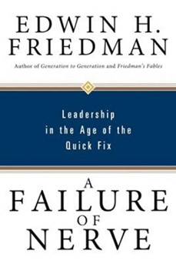
“As Friedman (1999) implied in the title of his classic book, “A Failure of Nerve: Leadership in the Age of the Quick Fix”, leadership is not easy. Being able to tolerate not knowing does not mean we stay in that position, but we stay in it long enough to find a better understanding and response to a problem. Not being able to tolerate the anxiety involved is likely to lead to reactive, counterproductive actions.” (Tomlinson, 2024a)
CHALLENGE. RESISTANCE. & AMBIVALENCE

Slide 97
7. The avoidance of pain is a human instinct individually, and in groups.
Friedman (2007, p.67) states the reality for any person, family, or organization that wants to improve,
“There is no way out of a chronic condition unless one is willing to go through an acute, temporarily more painful phase.”
CHALLENGE. RESISTANCE. & AMBIVALENCE

Slide 98
“GROWING PAINS”
The problem is, as Friedman (p.67) says, “that chronic conditions, precisely because they are more bearable, also tend to be more withering over time”. Most of us and organizations are likely to have a chronic condition or two!

Slide 99
“GROWING PAINS”
The familiar phrase ‘growing pains’ is a good metaphor for what is involved if we want to learn, grow, and mature as individuals, groups, and organizations. To grow we must let go of defences that are often dysfunctional.

Slide 100
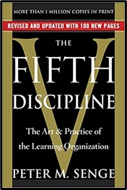
8. Effective 1-1 discussions expose our thinking.
Senge (1990, p.231) links our defensiveness with our formative experiences,
“For most of us, exposing our reasoning is threatening because we are afraid that people will find errors in it. The perceived threat from exposing our thinking starts early in life and, for most of us, is steadily reinforced in school—remember the trauma of being called on and not having the "right answer"—and later in work.”
CHALLENGE. RESISTANCE. & AMBIVALENCE

Slide 101
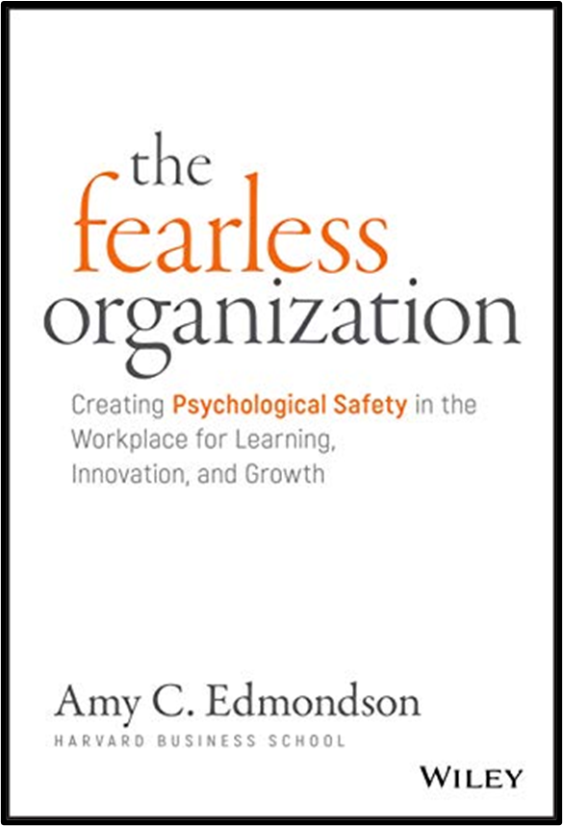
Edmondson (2019), in her book ‘The Fearless Organization’, has shown how fear is one of the main reasons people do not express their thoughts and ideas. This highlights how vital it is to work on establishing and maintaining trust.
CHALLENGE. RESISTANCE. & AMBIVALENCE

Slide 102
9. Useful and challenging 1-1 discussions might evoke fear of conflict.
A useful discussion may require debate, questioning, analysis, reflection, and critical thinking. Most of the time, this can feel positive and a helpful way of learning. However, people might also be familiar with debates and arguments that become a matter of right and wrong, winners and losers. This can become a hostile climate where people can easily become upset with each other. If so, a reparative process will be needed to restore a safe working relationship.
CHALLENGE. RESISTANCE. & AMBIVALENCE

Slide 103
This is one of the reasons why more frequent meetings help to create a sense of safety where difficult and productive conversations are possible. Less frequent meetings are more likely to get stuck at a superficial level and become conflictual in an unhelpful way.
CHALLENGE. RESISTANCE. & AMBIVALENCE

Slide 104
REFLECTIVE QUESTIONS & CONCLUSIONS

Slide 105
Gallup and other research have shown that employee engagement is critical to positive organizational performance and outcomes, and manager engagement is the most influential factor in employee engagement. The 1-1 meeting between the manager and direct report is at the centre of engagement.
REFLECTIVE QUESTIONS & CONCLUSIONS

Slide 106
REFLECTIVE QUESTIONS & CONCLUSIONS
The evidence suggests that investing in the development of high-quality 1-1 meetings is likely to be highly cost-effective on many levels. Rogelberg (p. xiv) claims that when organizations make 1:1 meetings “the pillar of their leadership they can radically change their cultures and productivity as a whole”.

Slide 107
It is recognized that the nature of these meetings will vary according to circumstances and context. However, the key principles are largely relevant across all industries. A useful guide for working out how often you should have a 1-1 meeting is to consider,
1. The complexity of the work involved
2. The emotional and relational content of the work
3. The risks involved and the consequences if the work is not carried out well
4. How experienced is the worker
As a rule of thumb, the higher the work scores in these factors, the more time for connecting, processing, and thinking will be necessary.
REFLECTIVE QUESTIONS & CONCLUSIONS

Slide 108
It may be difficult to know where to start, so it may be helpful to begin with some reflective questions and analysis of the present situation.
1) Is the purpose of 1-1 meetings clear, and how often do you have them?
2) How well do the meetings work – from both sides – do they feel helpful, useful, and productive?
REFLECTIVE QUESTIONS & CONCLUSIONS

Slide 109
3) Do the lead people who carry out the meetings feel clear that they have the knowledge and skills to be effective in the task? Especially, on how to help people with their professional and personal development.
4) What is the level of engagement like for individuals and the organization as a whole?
5) Are there signs that people are developing well?
6) Do people have a development plan to which they are committed?
REFLECTIVE QUESTIONS & CONCLUSIONS

Slide 110
7) Are there signs of disengagement, poor performance, high turnover, and sickness rates?
8) If you feel that your meeting processes you could review everything, including how 1-1 meetings fit with other types of meetings, such as, team meetings and reflective spaces. You could include the whole workforce in the review by carrying out a survey.
9) If you decide to make a change you can then plan and consider how the change will be supported. For example, will there need to be any training on how to implement effective 1-1 meetings.
REFLECTIVE QUESTIONS & CONCLUSIONS

Slide 111
10) It will be helpful to clarify the outcomes you desire to see from the meeting process. These outcomes can be performance and development based.
11) How will you know whether the process is working well or not?
REFLECTIVE QUESTIONS & CONCLUSIONS

Slide 112
Dr. Steven G. Rogelberg Brief Biography

Slide 113
Steven G. Rogelberg is a professor of Organizational Science, Management, and Psychology and the founding Director of Organizational Science at UNC, Charlotte. He has over 100 publications addressing issues such as team effectiveness, leadership, engagement, health and employee well-being, meetings at work, and organizational research methods. He is the editor of the Journal of Business and Psychology. Dr. Rogelberg has received over $2,500,000 of external grant funding, including from the National Science Foundation.
For a full wiki biography click here. https://en.wikipedia.org/wiki/Steven_Rogelberg

Slide 114
REFERENCES AND BIBLIOGRAPHY

Slide 115
Alderfer, C. P. (1972) Human Needs in Organizational Settings, New York: Free Press of Glencoe
Argyris, C. (1985) Strategy, Change, and Defensive Routines, Boston: Pitman
Argyris, C. (1991) Teaching Smart People How to Learn, in, Harvard Business Review, May-June 1991, https://hbr.org/1991/05/teaching-smart-people-how-to-learn
Bregman, P. (2016) The Right Way to Hold People Accountable, in, Harvard Business Review, https://hbr.org/2016/01/the-right-way-to-hold-people-accountable
Brown, B. (2018) Clear is Kind. Unclear is Unkind. https://brenebrown.com/articles/2018/10/15/clear-is-kind-unclear-is-unkind/
REFERENCES & BIBLIOGRAPHY

Slide 116
Byham, T. M. and Wellins, R. (2015) Your First Leadership Job: How Catalyst Leaders Bring out the Best in Others, John Wiley & Sons
Cardona, F. (2003) The Manager's Most Precious Skill: The Capacity to be `Psychologically Present', in, Organisational & Social Dynamics, 3(2)
Delizonna, L. (2017) High Performing Teams Need Psychological Safety. Here’s How to Create it, in, Harvard Business Review, https://hbr.org/2017/08/high-performing-teams-need-psychological-safety-heres-how-to-create-it?utm_medium=social&utm_campaign=hbr&utm_source=LinkedIn&tpcc=orgsocial_edit
REFERENCES & BIBLIOGRAPHY

Slide 117
Dweck, C. S. (2016) Mindset: The New Psychology of Success, New York: Penguin Random House L.L.C.
Edmondson, A.C. (2019) The Fearless Organization: Creating Psychological Safety in the Workplace for Learning, Innovation, and Growth, Hoboken, New Jersey: John Wiley & Sons
Friedman, E.H. (1999) A Failure of Nerve: Leadership in the Age of the Quick Fix, New York: Church Publishing, Inc.
Friedman, E.H. (2007) A Failure of Nerve: Leadership in the Age of the Quick Fix: 10th Anniversary Revised Edition, New York: Seabury Books
Gallup Report (2024) State of the Global Workplace: The Voice of the World’s Employees, Gallup Inc., https://www.gallup.com/workplace/349484/state-of-the-global-workplace.aspx

Slide 118
Gladwell, M. (2008) Outliers: The Story of Success, New York, Boston. London: Little, Brown and Company
Kahn, W.A. (1990) Psychological Conditions of Personal Engagement and Disengagement at Work, in, Academy of Management Journal, 1990, Vol. 33, No. 4, 692-724
Kahn, W. A. (1992) To be Fully There: Psychological Presence at Work, in, Human Relations, 45, 321-350
Kim, S., Lee, H. and Connerton, T.P. (2020) How Psychological Safety Affects Team Performance: Mediating Role of Efficacy and Learning Behavior, in, Frontiers in Psychology Journal, 24th July 2020, Seoul, South Korea, https://www.frontiersin.org/articles/10.3389/fpsyg.2020.01581/full

Slide 119
Liker, J.K. (2004) The Toyota Way: 14 Management Principles from the World’s Greatest Manufacturer, New York, Chicago, San Francisco, Lisbon, London, Madrid, Mexico City, Milan, New Delhi, San Juan, Seoul, Singapore, Sydney, Toronto: McGraw-Hill
Maccoby, M. (2007) Narcissistic Leaders: Who Succeeds and Who Fails, Boston, Massachusetts: Harvard Business School Press
Maslow, A.H. (1954) Motivation and Personality, New York: Harper & Row
Maslow, A.H. (1943) A Theory of Human Motivation, in, The Journal of Psychological Review, Vol 50, No. 4, https://www.academia.edu/9415670/A_Theory_of_Human_Motivation_Abraham_H_Maslow_Psychological_Review_Vol_50_No_4_July_1943

Slide 120
Mattinson, J. (1970) The Reflection Process in Casework Supervision, Tavistock Institute of Marital Studies
Menzies Lyth, I. (1979) Staff Support Systems: Task And Anti-Task in Adolescent Institutions (Originally a Paper Read to the Conference of The Association for the Psychiatric Study of Adolescents, July 1974), in, Menzies Lyth, I. (1988) Containing Anxiety in Institutions: Selected Essays Vol. 1, London: Free Association Books, https://www.johnwhitwell.co.uk/child-care-general-archive/task-and-anti-task-in-adolescent-institutions
Miller, E.J. (1993) The Healthy Organisation - Creating a Holding Environment: Conditions for Psychological Security, The Tavistock Institute https://www.johnwhitwell.co.uk/child-care-general-archive/the-healthy-organization-by-eric-miller/

Slide 121
Obholzer, A. (2021) Workplace Intelligence: Unconscious Forces and How to Manage Them, London and New York: Routledge
O.C. Tanner (2021) Global Culture Report: Crisis, https://www.octanner.com/global-culture-report/2021-crisis
Olson, J. (2013) The Slight Edge: Turning Simple Disciplines into Massive Success and Happiness, Plano, Texas: Success
Ralph, N.D. and Iszatt-White, M. (2016) Who Contains the Container? Creating a Holding Environment for Practicing Leaders, @, Conference: British Academy of Management, September 2016: Thriving in Turbulent Times https://www.researchgate.net/publication/307477422_Who_contains_the_container_Creating_a_holding_environment_for_practicing_leaders

Slide 122
Rice, A.K. (1963) The Enterprise and its Environment, London: Tavistock Publications
Risk and Resilience UK - Vicarious Trauma: A Toolkit for Organisations and Individuals www.risk-and-resilience.co.uk
Rogelberg, S. G. (2024) Glad We Met: The Art and Science of 1:1 Meetings, New York: Oxford University Press
Schön, D. (1983) The Reflective Practitioner: How Professionals Think in Action, London: Temple
Senge, P.M. (1990) The Fifth Discipline: The Art and Practice of the Learning Organization, Currency, Random House

Slide 123
Thiel, C. E., Bagdasarov, Z., Harkrider, L., Johnson, J. F., and Mumford, M. D. (2012) Leader Ethical Decision-Making in Organizations: Strategies for Sensemaking, in, Journal of Business Ethics, 107(1), 49-64, https://www.researchgate.net/publication/254426750_Leader_Ethical_Decision-Making_in_Organizations_Strategies_for_Sensemaking
Tomlinson, P. (2024a) 1-1 Line Manager-Direct Report Meetings in Complex, Emotional and Relational, High-Risk Work, https://www.patricktomlinson.com/1-1-line-manager-direct-report-meetings-in-complex-emotional-and-relational-high-risk-work-patrick-tomlinson-2024/103
Tomlinson, P. (2024b) Effective Workplace Meetings: Task, Leadership, Dynamics, and Culture https://www.patricktomlinson.com/effective-workplace-meetings-task-leadership-dynamics-and-culture-patrick-tomlinson-2024/98

Slide 124
Van der Kolk, B. A. (2005) Developmental Trauma Disorder: Toward a Rational Diagnosis for Children with Complex Trauma Histories, in, Psychiatric Annals, 35(5), 401-408
Wilson, P. (2003) Consultation and Supervision, Chapter 14, p.220-232, in, Adrian Ward, Kajetan Kasinski, Jane Pooley and Alan Worthington (Eds) (2003) Therapeutic Communities for Children and Young People, London and Philadelphia: Jessica Kingsley
Zinger, D. (2017) William Kahn: Q&A With the Founding Father of Engagement (Part 1), in, bobmorris.biz: Blogging on Business, https://bobmorris.biz/william-kahn-qa-with-the-founding-father-of-engagement-part-1

