Slide 1

MIND THE GAP: FINDING THE RIGHT SPEED FOR GROWTH IN PEOPLE AND ORGANIZATIONS (2026)

Slide 2
CONTENTS
Optimal Rates of Growth
Slow Down to go Fast
Mind the Gap
The Zone of Proximal Development
Scaffolding Development

Slide 3
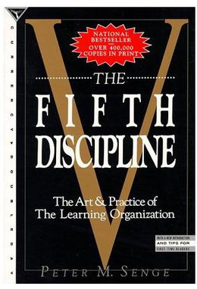
Peter Senge – The Fifth Discipline
Peter Senge (1990) referred to ‘optimal rates of growth’ in his business classic, The Fifth Discipline: The Art & Practice of the Learning Organization. In 1997, Harvard Business Review identified this as one of the seminal management books of the previous 75 years.

Slide 4
Optimal Rates of Growth
“Virtually all natural systems, from ecosystems to animals to organizations, have intrinsically optimal rates of growth. The optimal rate is far less than the fastest possible growth. When growth becomes excessive … the system itself will seek to compensate by slowing down; perhaps putting the organization’s survival at risk in the process.”

Slide 5

Slow Down to go Fast
“There’s a reason I titled an earlier chapter “Slow Down to Go Fast.” The Aesop fable was dead-on accurate: fast is not always optimal and often does not win the race.” (2013, p.206)

Slide 6
Too Fast can Risk Survival
“Going too fast, or growing too fast, often puts the system’s (or the person’s) survival at risk. Faster can easily turn out to be slower.” (p.206)

Slide 7
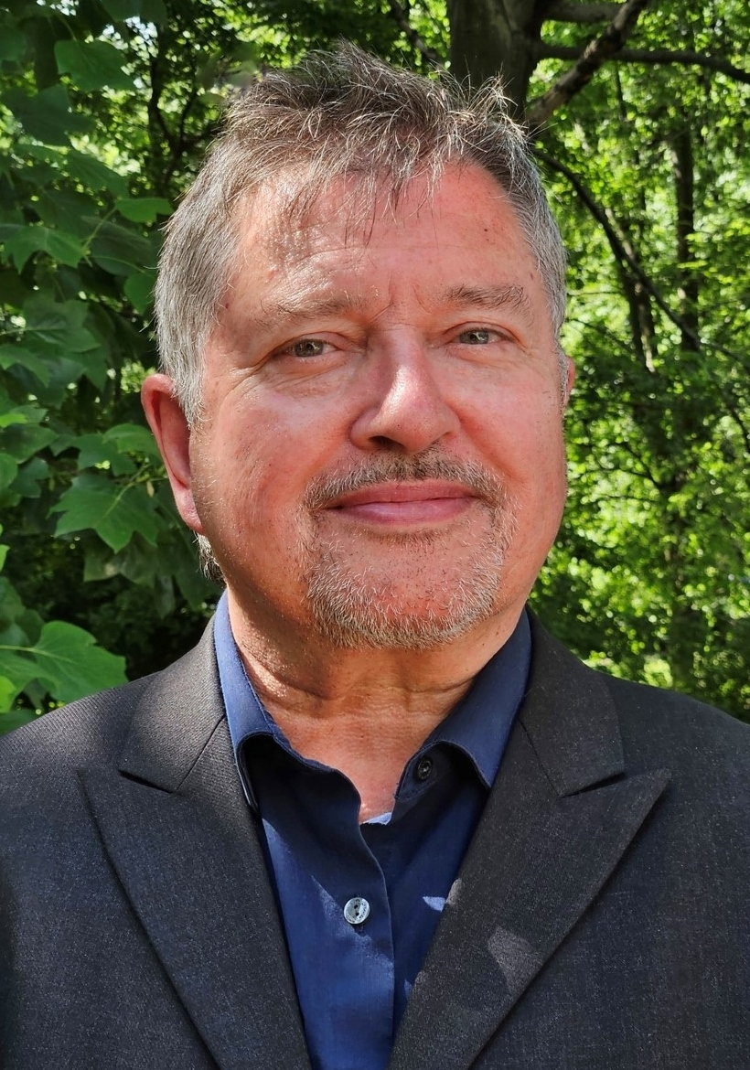
Finding the Right Pace
For optimal development, the pace of change and development should not be too comfortable but not excessively demanding. There is a gap between what someone is capable of on their own and what can be achieved with support.

Slide 8
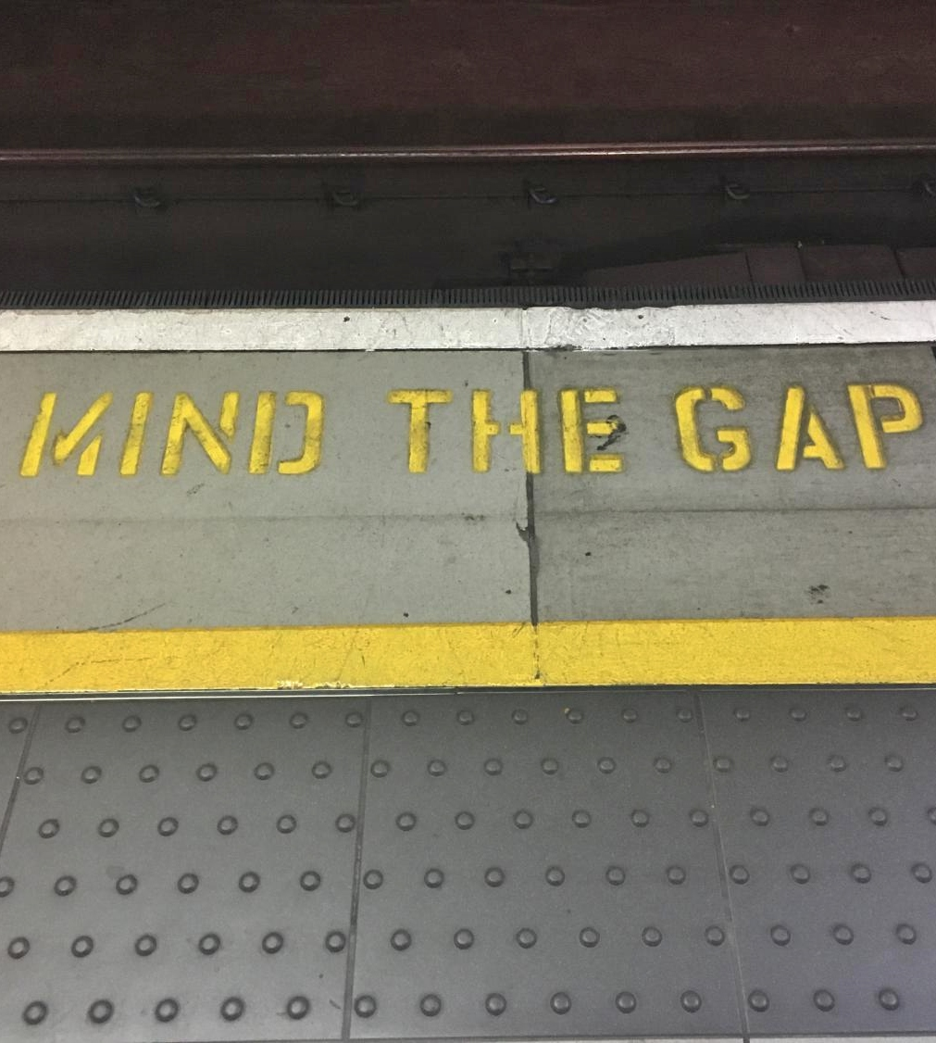
Mind the Gap
It is important that we are as aware as possible of the gap between where a person, group, or organization is currently and their potential capability, so that we can mind and bridge the gap. The bigger the gap, the more we need to mind it. For example, a small child needs a lot of minding.

Slide 9
The Right Size Gap
A gap is necessary for growth. The question is the size of the gap. Too little and no room to grow. Too big, and the situation is potentially overwhelming and unsafe.

Slide 10
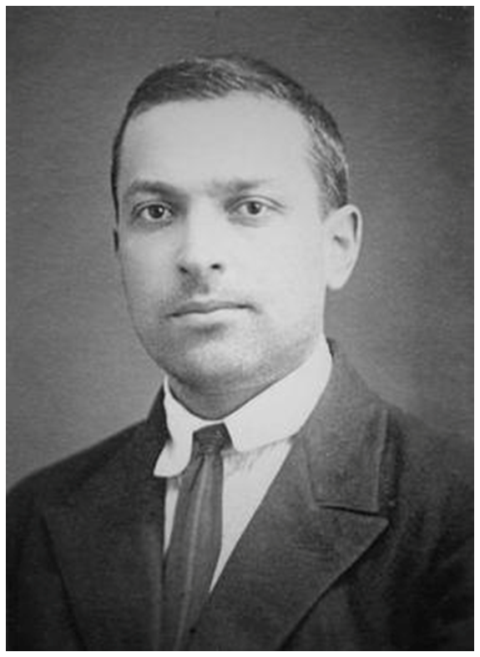
Vygotsky’s Zone of Proximal Development
This gap is like the Russian psychologist Lev Vygotsky’s (1978) concept of the ‘Zone of Proximal Development (ZPD)’, or how the person can function on their own compared to how they could function with the input of others.

Slide 11
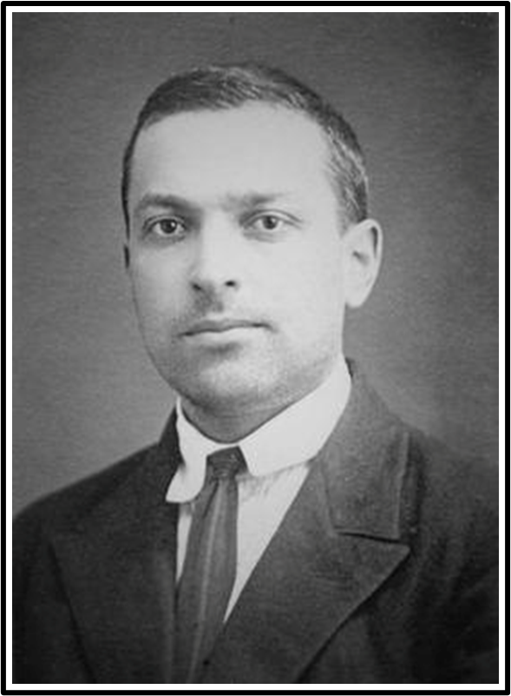
Scaffolding Development
The support necessary to enable the person to move from where they are now to where they could be, Vygotsky termed ‘scaffolding’. The same concepts can be applied to the development of individuals, groups, and organizations.

Slide 12
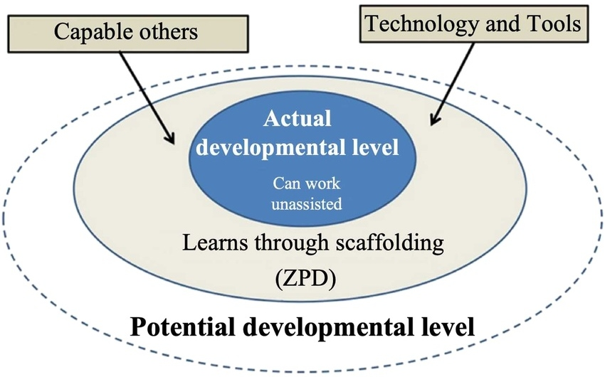
ZPD - Development & Scaffolding

Slide 13
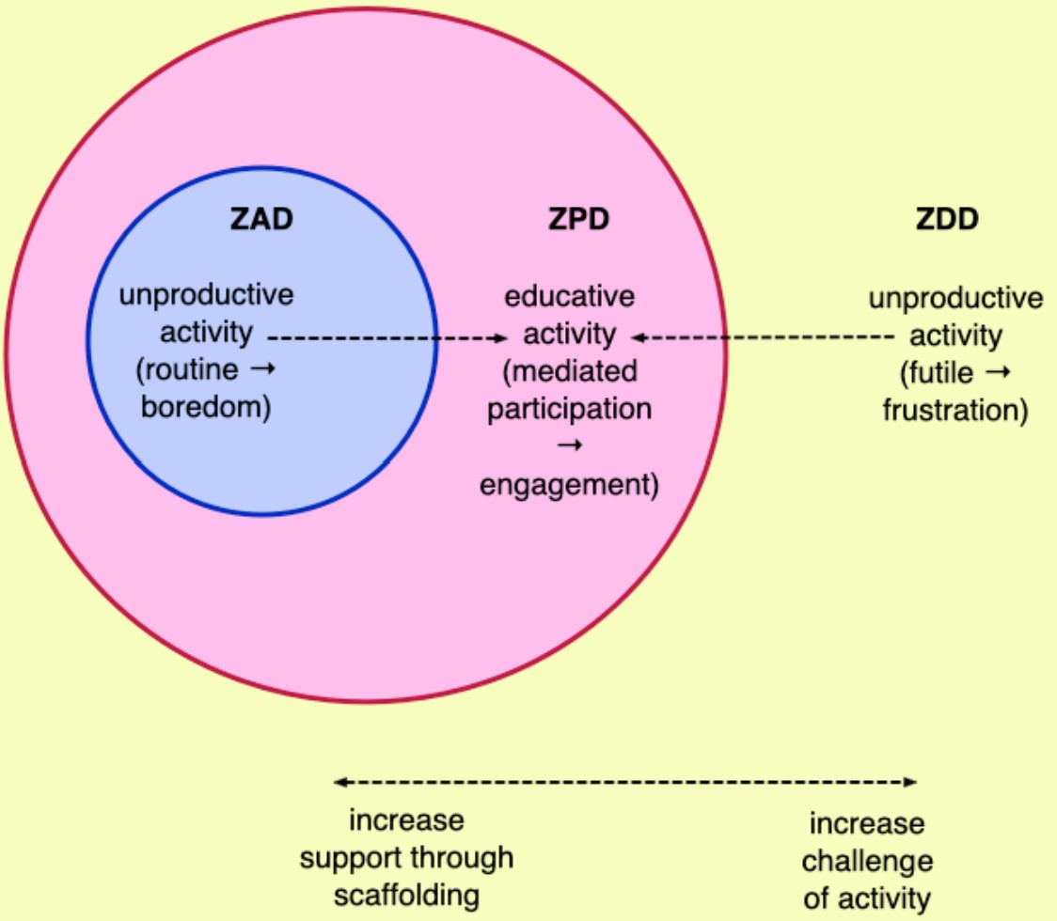
The Most Productive Learning Takes Place in ZPD
(Taber, 2020)
ZAD – Zone of Actual Development, is what the person can already do independently, without any help. The gap is too small.
ZDD is where the demands are too far beyond the person’s current capability, even with support.​
Activity here tends to be futile and frustrating; the gap is too big, so the experience becomes overwhelming rather than developmental.

Slide 14
Key Takeaways
Growth requires a gap – but the gap must be optimal, not overwhelming.
Faster is not always better – sometimes we need to slow down to go fast or go backwards to go forward.
Mind the gap – provide scaffolding that matches the person's or organization's current capacity.

Slide 15
Questions for Reflection
Where is the gap between current and potential capability?
Is the pace of change optimal or overwhelming?
What scaffolding is needed to support growth?
Are we slowing down enough to go fast later?

Slide 16
Applying to Your Context
What changes are currently underway in your team or organization?
Who might be in their zone of proximal development right now?
Where might we be going too fast and risking the system?

Slide 17
REFERENCES
Olson, J. (2013) The Slight Edge: Turning Simple Discipline into Massive Success & Happiness, Austin, Texas: Greenleaf Book Group Press
Senge, P.M. (1990) The Fifth Discipline: The Art and Practice of the Learning Organization, Currency: Random House
Taber, K. S. (2020) Mediated Learning Leading Development – The Social Development Theory of Lev Vygotsky, in, B. Akpan & T. Kennedy (Eds.), Science Education in Theory and Practice: An Introductory Guide to Learning Theory, Springer
Vygotsky, L.S. (1978) Mind and Society: The Development of Higher Psychological Processes, Cambridge, MA: Harvard University Press

