Slide 1

A FEW UNIVERSAL
PRINCIPLES OF LEADERSHIP

Slide 2
CONTENTS
Introduction
Research Reading Reflection
The Importance of Context
Managing Oneself & Learning
Emotional Containment
Micro-management & Delegation
Effective Task Performance & Staff Support
Uncertainty, Decision-making, & Judgement
Emotional Intelligence & Strategic Intelligence
Organizational System Dynamics & Leadership
References

Slide 3
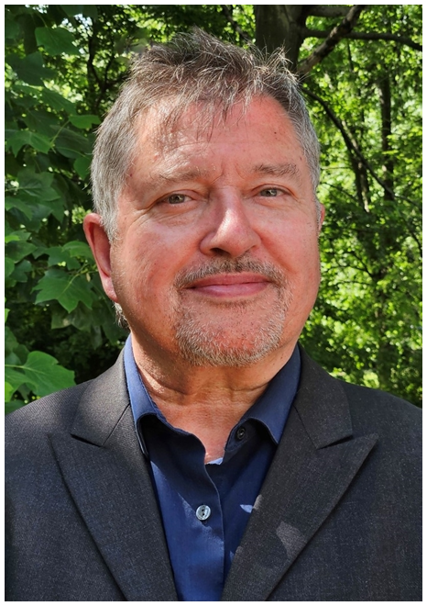
I have been in leadership roles for over 35 years, as a team leader, senior manager, director, CEO, non-executive director, consultant, and leadership development mentor. My experiences and research in different cultures and fields of leadership have helped me understand some of the universal principles of leadership.
Universal Principles of Leadership

Slide 4
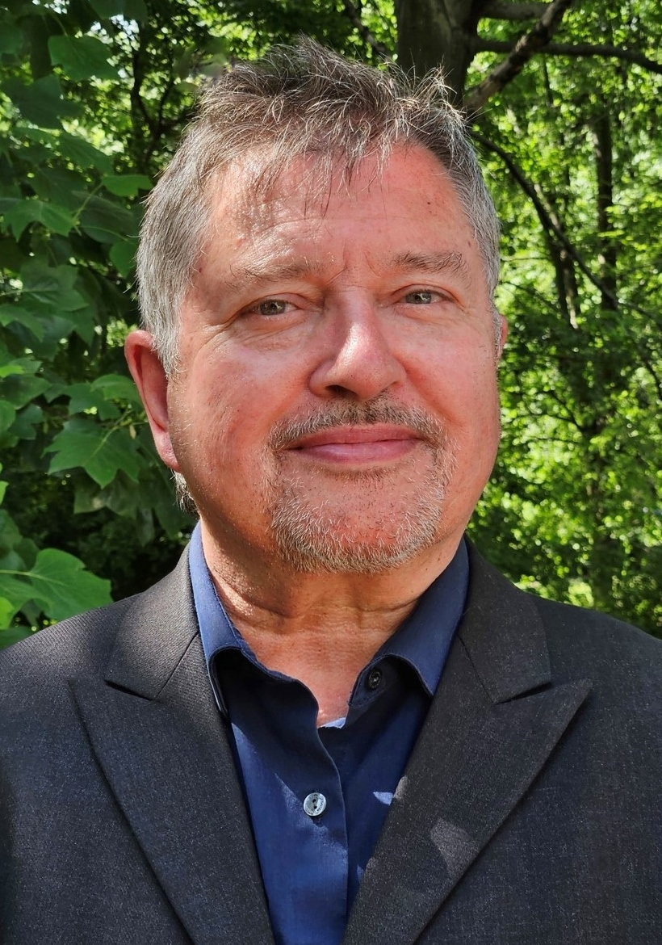
This collection of slides captures some of the principles that I find most helpful. I know from experience that these principles make sense. In some cases, the outcomes of applying them along with the mindsets that go with them have been transformational.
Universal Principles of Leadership

Slide 5
In recent years, some of the most useful things I have learned about leadership come from the military field. For example, I would not have expected that reading relevant books is mandatory in the US Marines and that reflective practice is part of military training and culture. We tend to get stuck in our silos.
Universal Principles of Leadership

Slide 6
The principles captured here represent views from many fields of work, including: The Military, Human Services, Business Theory, Systems Theory, Executive Leadership, & Leadership Development.
I think they are important and helpful views on leadership. I hope you find something useful among them.
Universal Principles of Leadership

Slide 7
RESEARCH READING
REFLECTION

Slide 8
When I say research, I mean reflecting on my day-to-day work experiences, reading, and thinking. This is one of the principles of leadership. How do you understand how well you are doing your work if you haven’t explored the vast history, experience, and ideas of those who have been in or are in similar roles?
Research = Reflecting on Experience + Reading + Thinking

Slide 9
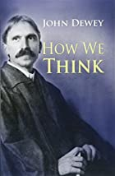
“We do not learn from experience – we learn from reflecting on experience.”
John Dewey (1910) - Philosopher, psychologist, and educational reformer.
Research = Reflection

Slide 10
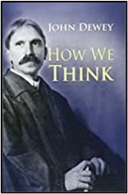
Besides learning from others, reading creates the discipline of perspective-taking and reflective thinking. It’s not just about gaining knowledge. Our way of thinking is changed. It changes how we think which can be more important than what we know (Dewey).
Learning = Reflective Thinking

Slide 11
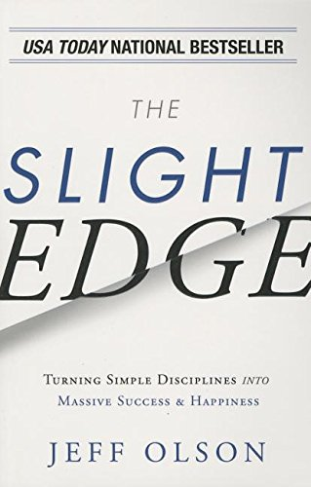
In his book on Personal and Professional Development, Olson (2013, p.260) says his top recommendation for development is reading at least ten pages of a relevant book every day and “Building your own personal self-improvement library may be the single most valuable and important investment (after your personal health) that you can make”.
Research = Reading + Thinking

Slide 12
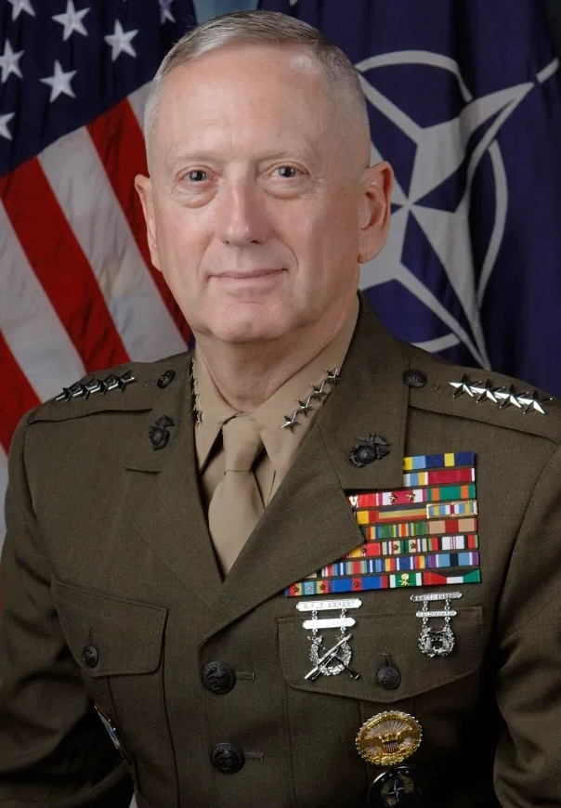
James Mattis, ex-USA Secretary of Defence & Marine Corps four-star General. He has a personal collection of 7,000 books.
“….The problem with being too busy to read is that you learn by experience (or by your men’s experience), i.e., the hard way. By reading, you learn through others’ experiences, generally a better way to do business, especially in our line of work where the consequences of incompetence are so final for young men.”
Reading + Reflective Thinking = Preparation

Slide 13
Highlighting the importance of reflection in leadership, General James Mattis of the United States Marine Corps said,
“If I was to sum up the single biggest problem of senior leadership in the Information Age, it’s a lack of reflection.”
Leadership = Reflection

Slide 14
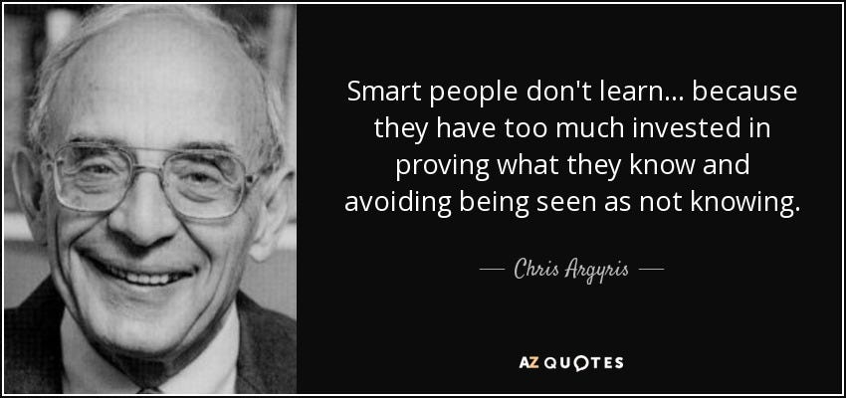
Why Smart People can Find it Difficult to Learn (Argyris, 1991)

Slide 15
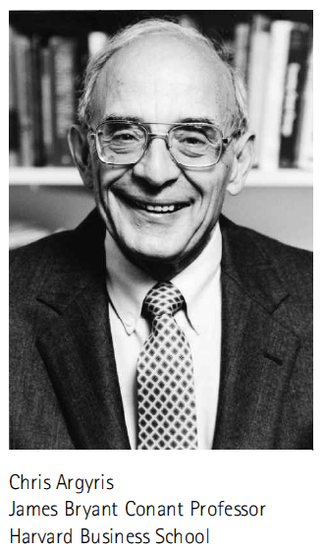
“Most people define learning too narrowly as mere 'problem-solving', so they focus on identifying and correcting errors in the external environment. Solving problems is important. But if learning is to persist, managers and employees must also look inward. They need to reflect critically on their own behaviour, identify the ways they often inadvertently contribute to the organisation’s problems, and then change how they act.”
(Argyris, 1991)
Leadership = Reflection

Slide 16
THE IMPORTANCE
OF CONTEXT

Slide 17
There is no such thing as a leader, only a leader and a context.
This is a key universal principle of leadership that is not emphasized enough. Leadership skills and styles are often discussed without reference to any context.
There is no Such Thing as a Leader …

Slide 18
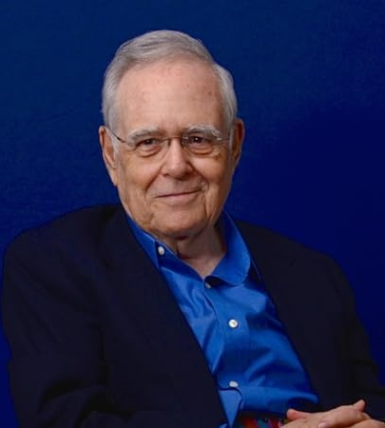
“Leadership always implies a context. Somebody could be a good leader in one context effective and in another context they're not. A good example is Winston Churchill. Winston Churchill was the indispensable leader of Britain in World War Two but was rejected by the British public both before and after the war. …
The Importance of Context

Slide 19
The same qualities, and abilities, and yet at one point he's a great leader and at the other two points he's not a leader at all … there are many examples of it, so leadership always requires thinking in terms of a context.” (Maccoby, 2015)
The Importance of Context

Slide 20
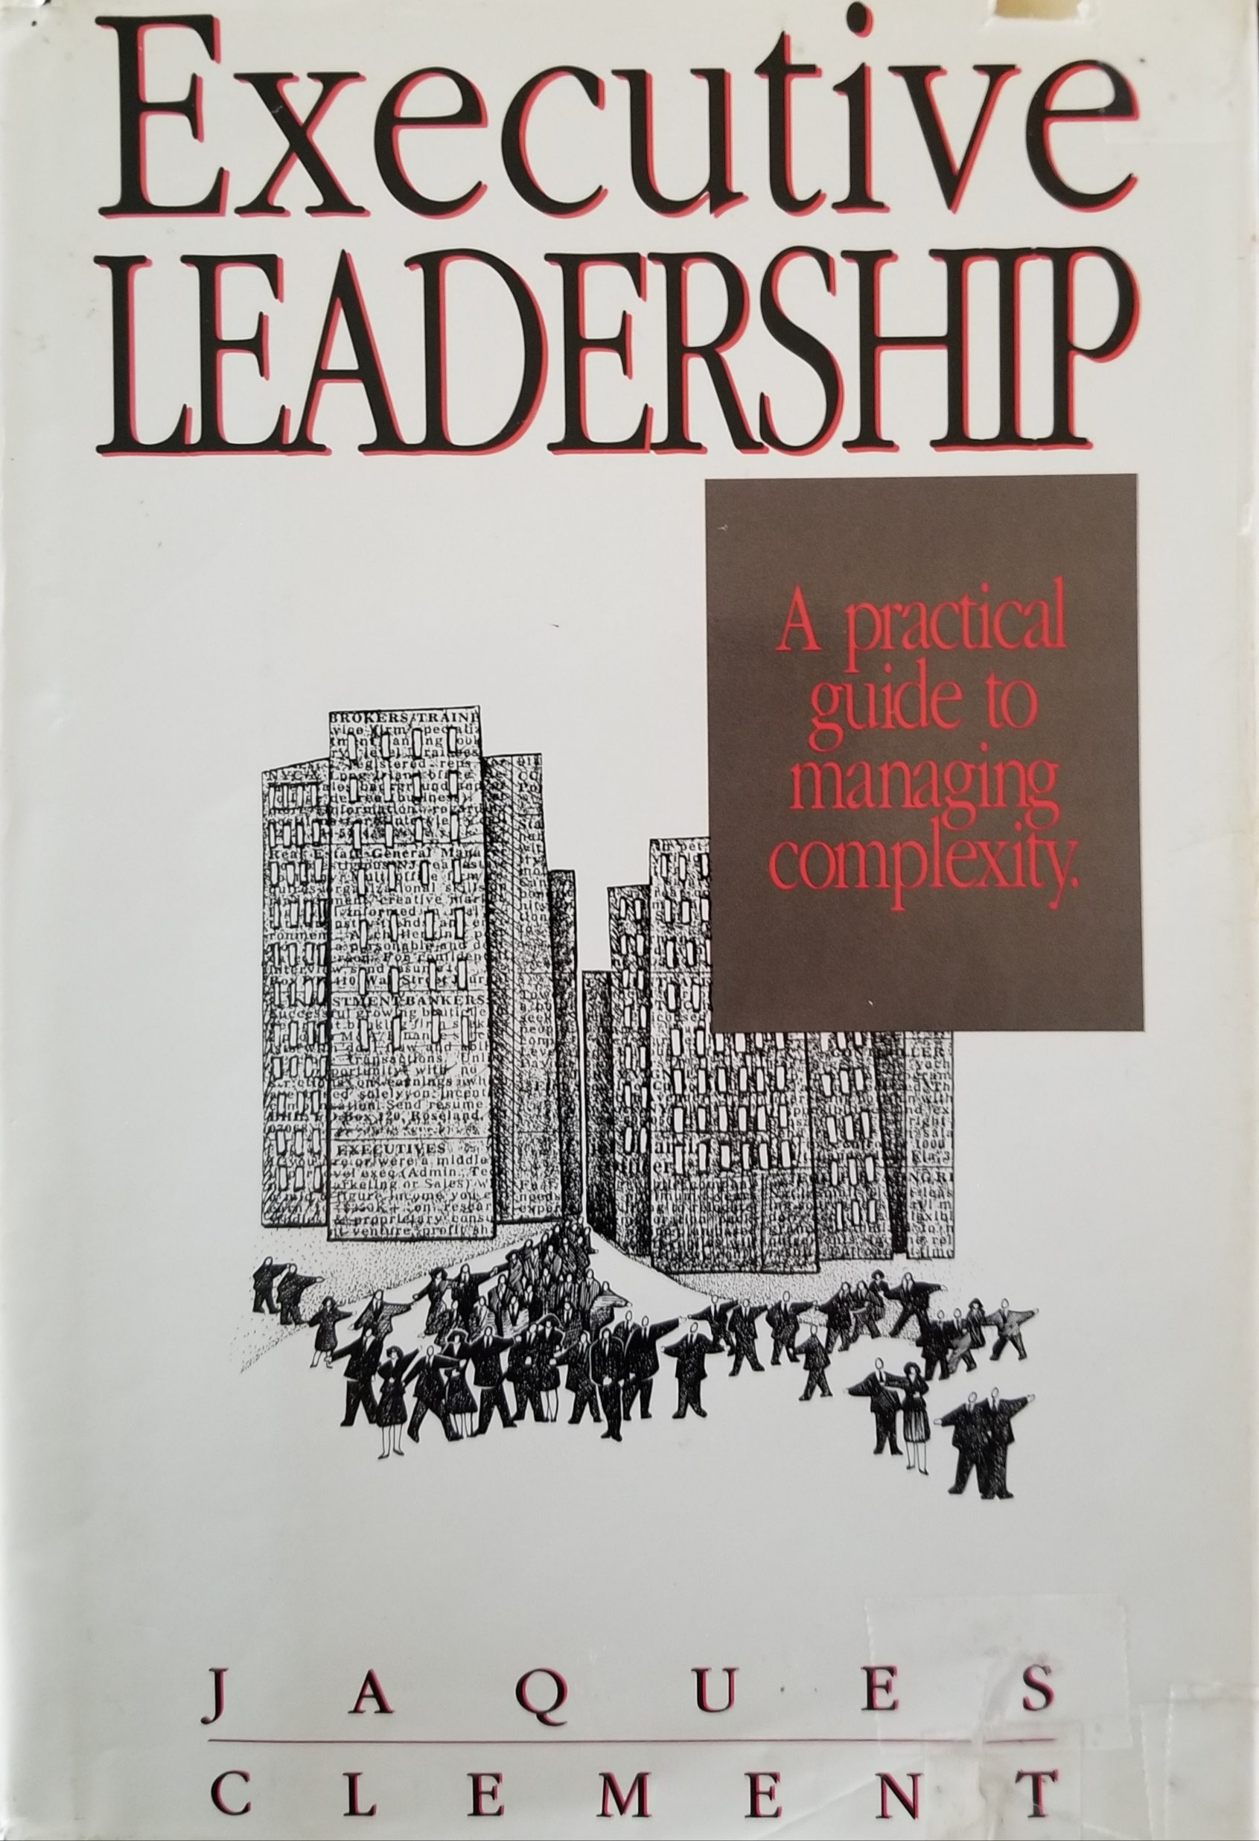
No Such Thing as a Leader Without a Context
“But, as we have suggested, there can be no such thing as a “leadership “ role, no such thing as a leader-follower role relationship. By the same token, there is no such thing as leader per se, and so we shall not use the term “leader” on its own in this book but will use “managerial leader” or “political leader” as appropriate. …

Slide 21
No Such Thing as a Leader Without a Context
Churchill was a hugely effective wartime commander-prime minister, but was not effective as peacetime prime minister. The roles were very different.” (Jaques and Clement, 1991, p.6)

Slide 22
MANAGING ONESELF
& LEARNING

Slide 23
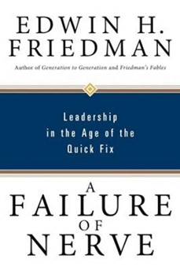
“…. all leadership begins with the management of one’s own health.”
(Friedman, 1999, p.234)
“…. a leader functions as the immune system of the institution or organization he or she ‘heads’.” (p.182)

Slide 24
“I begin with healing because the amount of responsibility one takes for his or her own life is the quintessential issue of leadership and self. The thinking involved in how anyone “manages” his or her own health encapsulates all critical issues of management.” (Friedman, 1999, p.100)

Slide 25
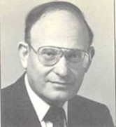
Anxiety & Playfullness
“A major criterion for judging the anxiety level of any society is the loss of its capacity to be playful.”
“Playfulness can get you out of a rut more successfully than seriousness.”
(Friedman, 1999, p.64)

Slide 26
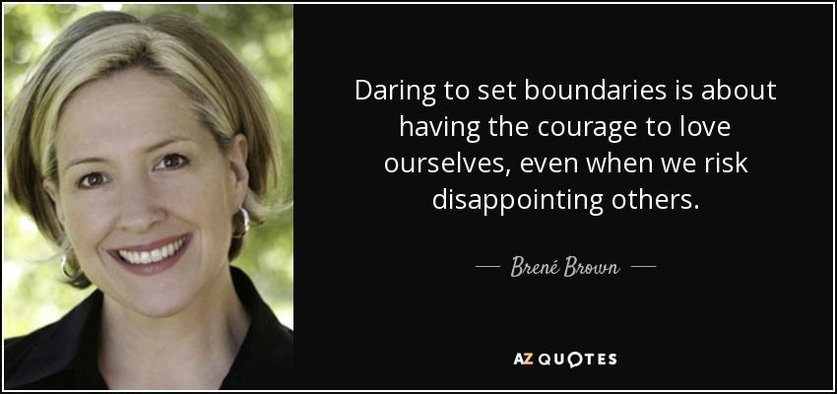
Self-differentiation & Boundaries

Slide 27

Brené Brown on Boundaries
“One of the most shocking findings of my work was the idea that the most compassionate people I have interviewed over the last 13 years were also the absolutely most boundaried.”
“The definition of boundary that I use in the book is simply what's okay and what's not okay.”

Slide 28
Nothing is Sustainable Without Boundaries
“Empathy minus boundaries is not empathy. Compassion minus boundaries is not genuine. Vulnerability without boundaries is not vulnerability. So, you see that there's a huge riff here, which is boundaries are freaking important, and it's not they're not fake walls. They're not separation, boundaries are not division. They're respect because here's what's okay for me and here's what's not.”

Slide 29
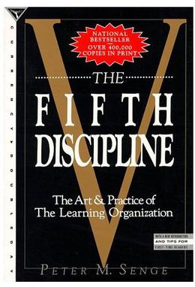
Optimal Rates of Growth
Peter Senge (1990) put it in his business classic, The Fifth Discipline: The Art & Practice of the Learning Organization. In 1997, Harvard Business Review identified this as one of the seminal management books of the previous 75 years.
“Virtually all natural systems, from ecosystems to animals to organizations, have intrinsically optimal rates of growth. The optimal rate is far less than the fastest possible growth. When growth becomes excessive—as it does in cancer—the system itself will seek to compensate by slowing down; perhaps putting the organization’s survival at risk in the process.”

Slide 30
The 5 Disciplines of a Learning Organization
1. "Personal mastery is a discipline of continually clarifying and deepening our personal vision, of focusing our energies, of developing patience, and of seeing reality objectively."[2]
2. "Mental models are deeply ingrained assumptions, generalizations, or even pictures of images that influence how we understand the world and how we take action."

Slide 31
The 5 Disciplines of a Learning Organization
3. "Building shared vision - a practice of unearthing shared pictures of the future that foster genuine commitment and enrollment rather than compliance.“
4. "Team learning starts with 'dialogue', the capacity of members of a team to suspend assumptions and enter into genuine 'thinking together’.”
5. "Systems thinking - The Fifth Discipline that integrates the other four."

Slide 32
Closing the Gap
This is a process which takes time.
“Sometimes you need to slow down to go fast.” (Olson, 2013, p.77)
“There’s a reason I titled an earlier chapter “Slow Down to Go Fast.” The Aesop fable was dead-on accurate: fast is not always optimal, and often does not win the race.” (p.206)

Slide 33
Going at the Right Speed
“Going too fast, or growing too fast, often put’s the system’s (or the person’s) survival at risk. Faster can easily turn out to be slower.” (Olson, 2013, p.206)
“In the meantime, it is important that we can be aware as possible of the gap, so that we ‘can mind the gap’.
The bigger the gap the more we need to mind it. For example, a small child needs a lot of minding. A gap is necessary for growth. The question is the size of the gap. Too little and no room to grow. Too big and the situation is potentially overwhelming and unsafe.”
(Tomlinson, 2022)

Slide 34
ORGANIZATIONAL LEARNING
Learning from Experience – Strong organizations and people are ones who learn from experience, or as John Dewey (1910, 1933, p.78, cited in Beard & Wilson, 2013, p.28) said,
‘We do not learn from experience … we learn from reflecting on experience’.
Becoming a learning organization is central to establishing a culture that is always developing, adapting, and progressing.
Asking questions and being curious is an important part of this.

Slide 35
EMOTIONAL CONTAINMENT

Slide 36
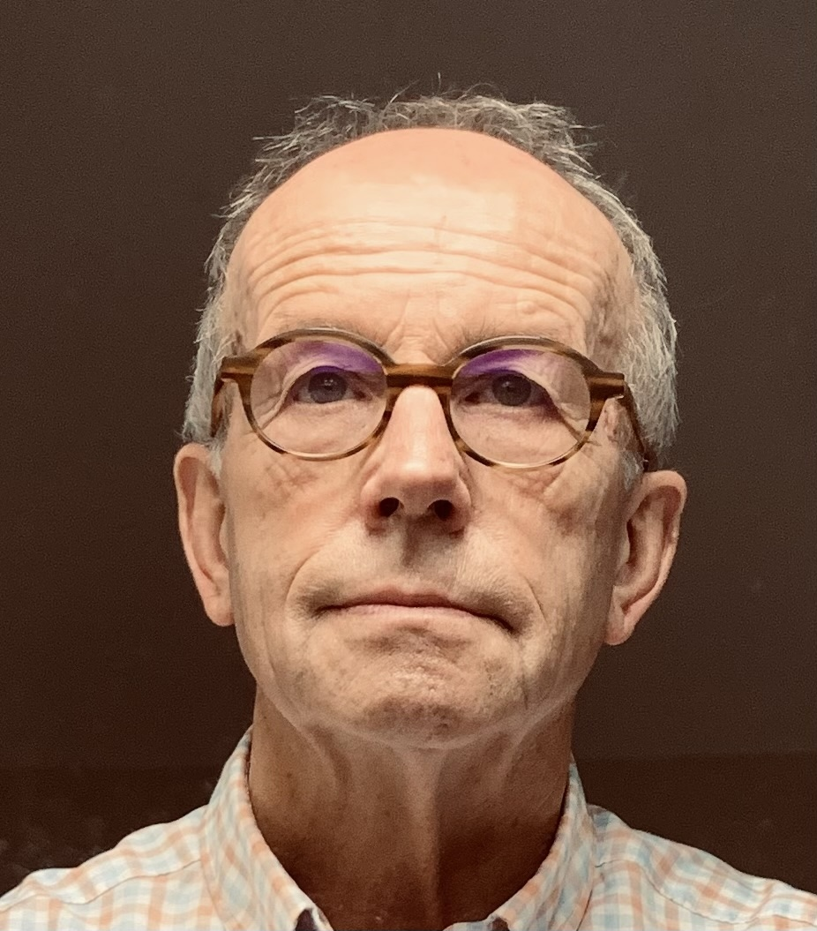
The Importance of Leadership & Management in Trauma Service Organizations
“For an organization to stay on task, clear management and leadership are essential. Whitwell (2009, p.3) stated,
“Therapeutic communities need to have leaders who are clear about the primary task and who are knowledgeable about therapeutic work with emotionally disturbed children.” (in, Barton, Gonzalez, and Tomlinson, 2012, p.177)

Slide 37
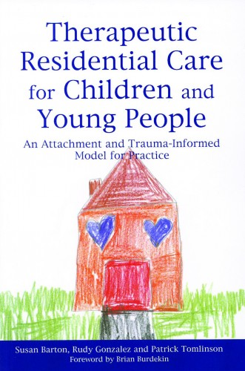
The Importance of Leadership & Management in Trauma Service Organizations
“Achieving the appropriate level of clarity is one of the biggest challenges for organizations working with traumatized children. There is a danger that management and therapy are seen to be in conflict with each other, rather than two complementary aspects of the treatment environment for children. …

Slide 38
The Importance of Leadership & Management in Trauma Service Organizations
… Children, who have been traumatized from an early age, need an environment that is well managed and emotionally containing.”
(Barton, Gonzalez, and Tomlinson, 2012, pp.177-178)

Slide 39
Leadership is an Emotional Process
Leaders must be as clear as possible about their emotions. Then they can respond rather than react to the emotional context around them. Friedman (199, p.117) states,
“Emotions do not simply modify thinking, reasoning, or decision making processes; they are part and parcel of the process of reasoning. Cerebration, in other words, involves more than logic, and thinking involves more than cerebration. “Mental” includes feelings. And the brain’s method of processing data always includes emotional variables.”

Slide 40
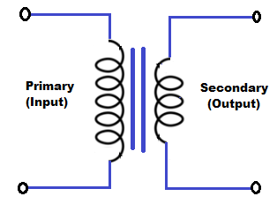
Transformer & Containment
Friedman (1999, p.232) uses the metaphor of a transformer in an electrical circuit to describe the process of emotional containment. The electrical current (anxiety) enters the transformer. The transformer can either be designed to step-up or step-down the current. He refers to a comment made to him,
“My mother was a step-up transformer, all right. If there was anxiety in the room and she was present, you could count on it escalating. It went into her at 110 and came out at 11,000.”

Slide 41
Transformer & Containment
“To the extent that leaders and consultants can maintain a non-anxious presence in a highly energized anxiety field, they can have the same effects on that field that transformers have in an electrical circuit.” (Friedman, 1999, p.232)

Slide 42
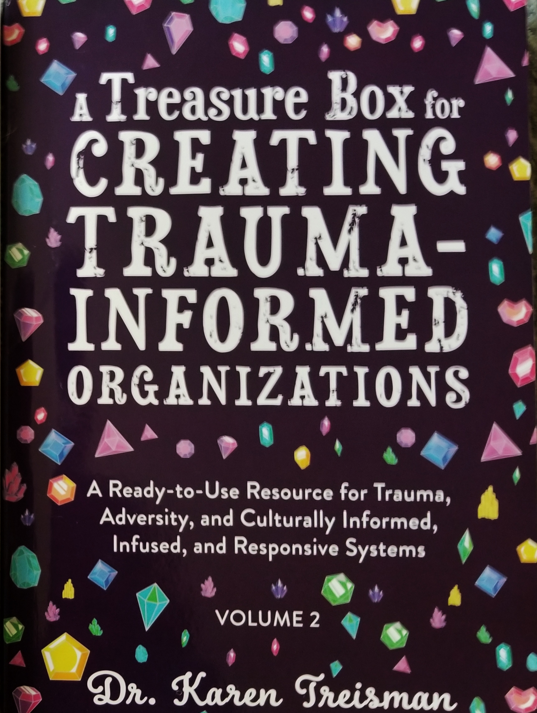
Transformer and Containment
“The leader must be capable of remaining separate, but not uninvolved. Maintaining clear boundaries is especially important and difficult. Trauma often occurs in environments where boundaries are muddled and sometimes non-existent. The leader needs to have a calming non-anxious presence.” (Tomlinson, 2021, p.65)

Slide 43
MICRO-MANAGEMENT
& DELEGATION

Slide 44
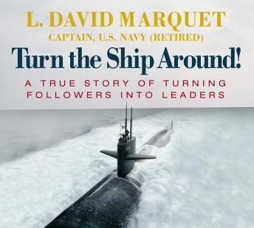
EFFECTIVE DELEGATION - 1
“Resist the urge to provide solutions…. despite the time it would have taken, I should have let my officers figure things out.” (Marquet, 2012, p.91)
“When I, as the captain, would ‘think out loud,’ I was in essence imparting important context and experience to my subordinates. I was also modelling that lack of certainty is strength and certainty is arrogance.” (p.106)

Slide 45
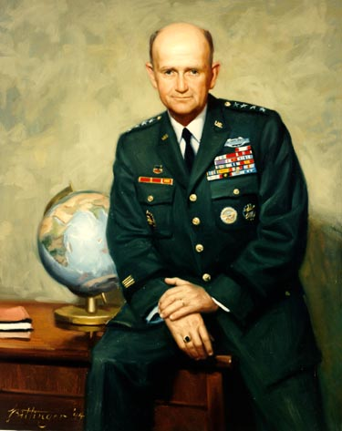
EFFECTIVE DELEGATION - 2
This is one of the universal phenomena that support positive outcomes in organizations and human development. It is interesting how similar the following two comments are here. The first is by General Gordon R. Sullivan (quoted in Ulrich, 1998), Chief of Staff to the USA Army,
“Once the Commander’s intent is understood, decisions must be devolved to the lowest possible level to allow these frontline soldiers to exploit the opportunities to develop.”

Slide 46
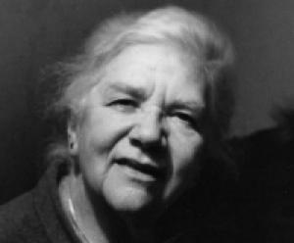
EFFECTIVE DELEGATION - 3
Isabel Menzies Lyth makes the same point about running a residential therapeutic community for children (1985, p.239).
“It is in general good management practice to delegate tasks and responsibilities to the lowest level at which they can be competently carried out and to the point at which decision-making is most effective.”

Slide 47
EFFECTIVE DELEGATION - 3
Menzies Lyth was an organizational consultant, mainly to the human services in the UK.
Whether we are talking about hospitals, the military, or parenting, the principle is the same. To develop and function effectively, people need the appropriate space to operate in.

Slide 48
Over-functioning in Another’s Space (Micro-Management)
The rabbi, family therapist, and leadership consultant, Edwin H. Friedman (1999, p.181), explains the opposite of effective delegation,
“I know how to teach any family or organizational member, regardless of size, how to make another member of that system dysfunctional. I would simply teach them how to overfunction in the other’s space. While terms such as codependency and enabling suggest something similar, they focus on behaviour or perhaps adaptation to another’s behavior. When one overfunctions in another’s space, the existential reality is much deeper: it can cause another’s being to disintegrate.”

Slide 49
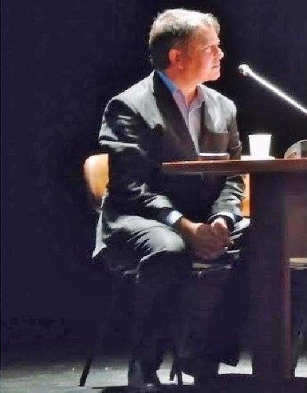
The Tendency to Micro-Manage
“One powerful dynamic, which may be related to anxiety and fear of not being in control, can be the tendency to micro-manage. Taking ‘control’ of everything may feel like a way of preventing anything from going wrong. The consequences of this approach, unless it is temporary, can be disastrous, because,

Slide 50
The Tendency to Micro-Manage
It conveys a lack of trust in the ability of others
It undermines the potential for others to grow and develop
It is not actually possible to sustain – the person operating like this will most likely burnout
It can only be done by ignoring other matters, such as big picture issues and strategic development
Organization boundaries - who is accountable and responsible for what are likely to become very blurred and muddled. (Tomlinson, P., 2005)”

Slide 51
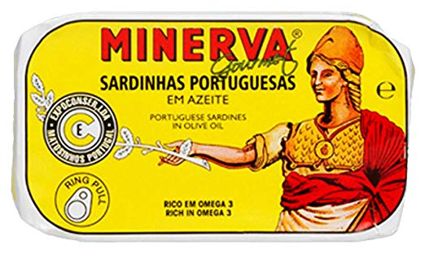
“… if managerial roles are too tightly stacked on top of each other, conflict will arise. The managers will feel insecure in dealing with subordinates who are too close to them in capability, and the subordinates will feel frustrated and irritated at having a manager who “breathes down our necks”.” (Jaques and Clement, 1991)
Operating Space

Slide 52
Influencing Upwards
“If subordinates do not feel that they have some real upward influence with their manager, then over time they will simply stop providing such advice or feedback.” (p.166)
“Managers build trust by setting limits at levels consistent with their subordinates’ cognitive complexity.” (p.xix)

Slide 53
Influencing Upwards
“The art of facilitating individual development, therefore, involves taking note of the rate of growth of a particular person’s potential, and providing work opportunities consistent with that growth.” (p.xviii)

Slide 54
EFFECTIVE TASK PERFORMANCE
& STAFF SUPPORT

Slide 55
EFFECTIVE TASK PERFORMANCE & STAFF SUPPORT
Isabel Menzies Lyth was a leading organizational and leadership consultant based at the Tavistock Institute of Human Relations (TIHR) in London. TIHR developed the concept of an organization as an open system and worked in hugely diverse industries across the world. As I experienced her work, I will refer to some of the key things I learned.

Slide 56
EFFECTIVE TASK PERFORMANCE & STAFF SUPPORT
“The responsibility of management for effective task-performance is a contribution to staff support, both through positive job satisfaction and through protecting staff from the anxiety, guilt and depression that arise from inadequate task-performance.”
(1979, p.222)

Slide 57
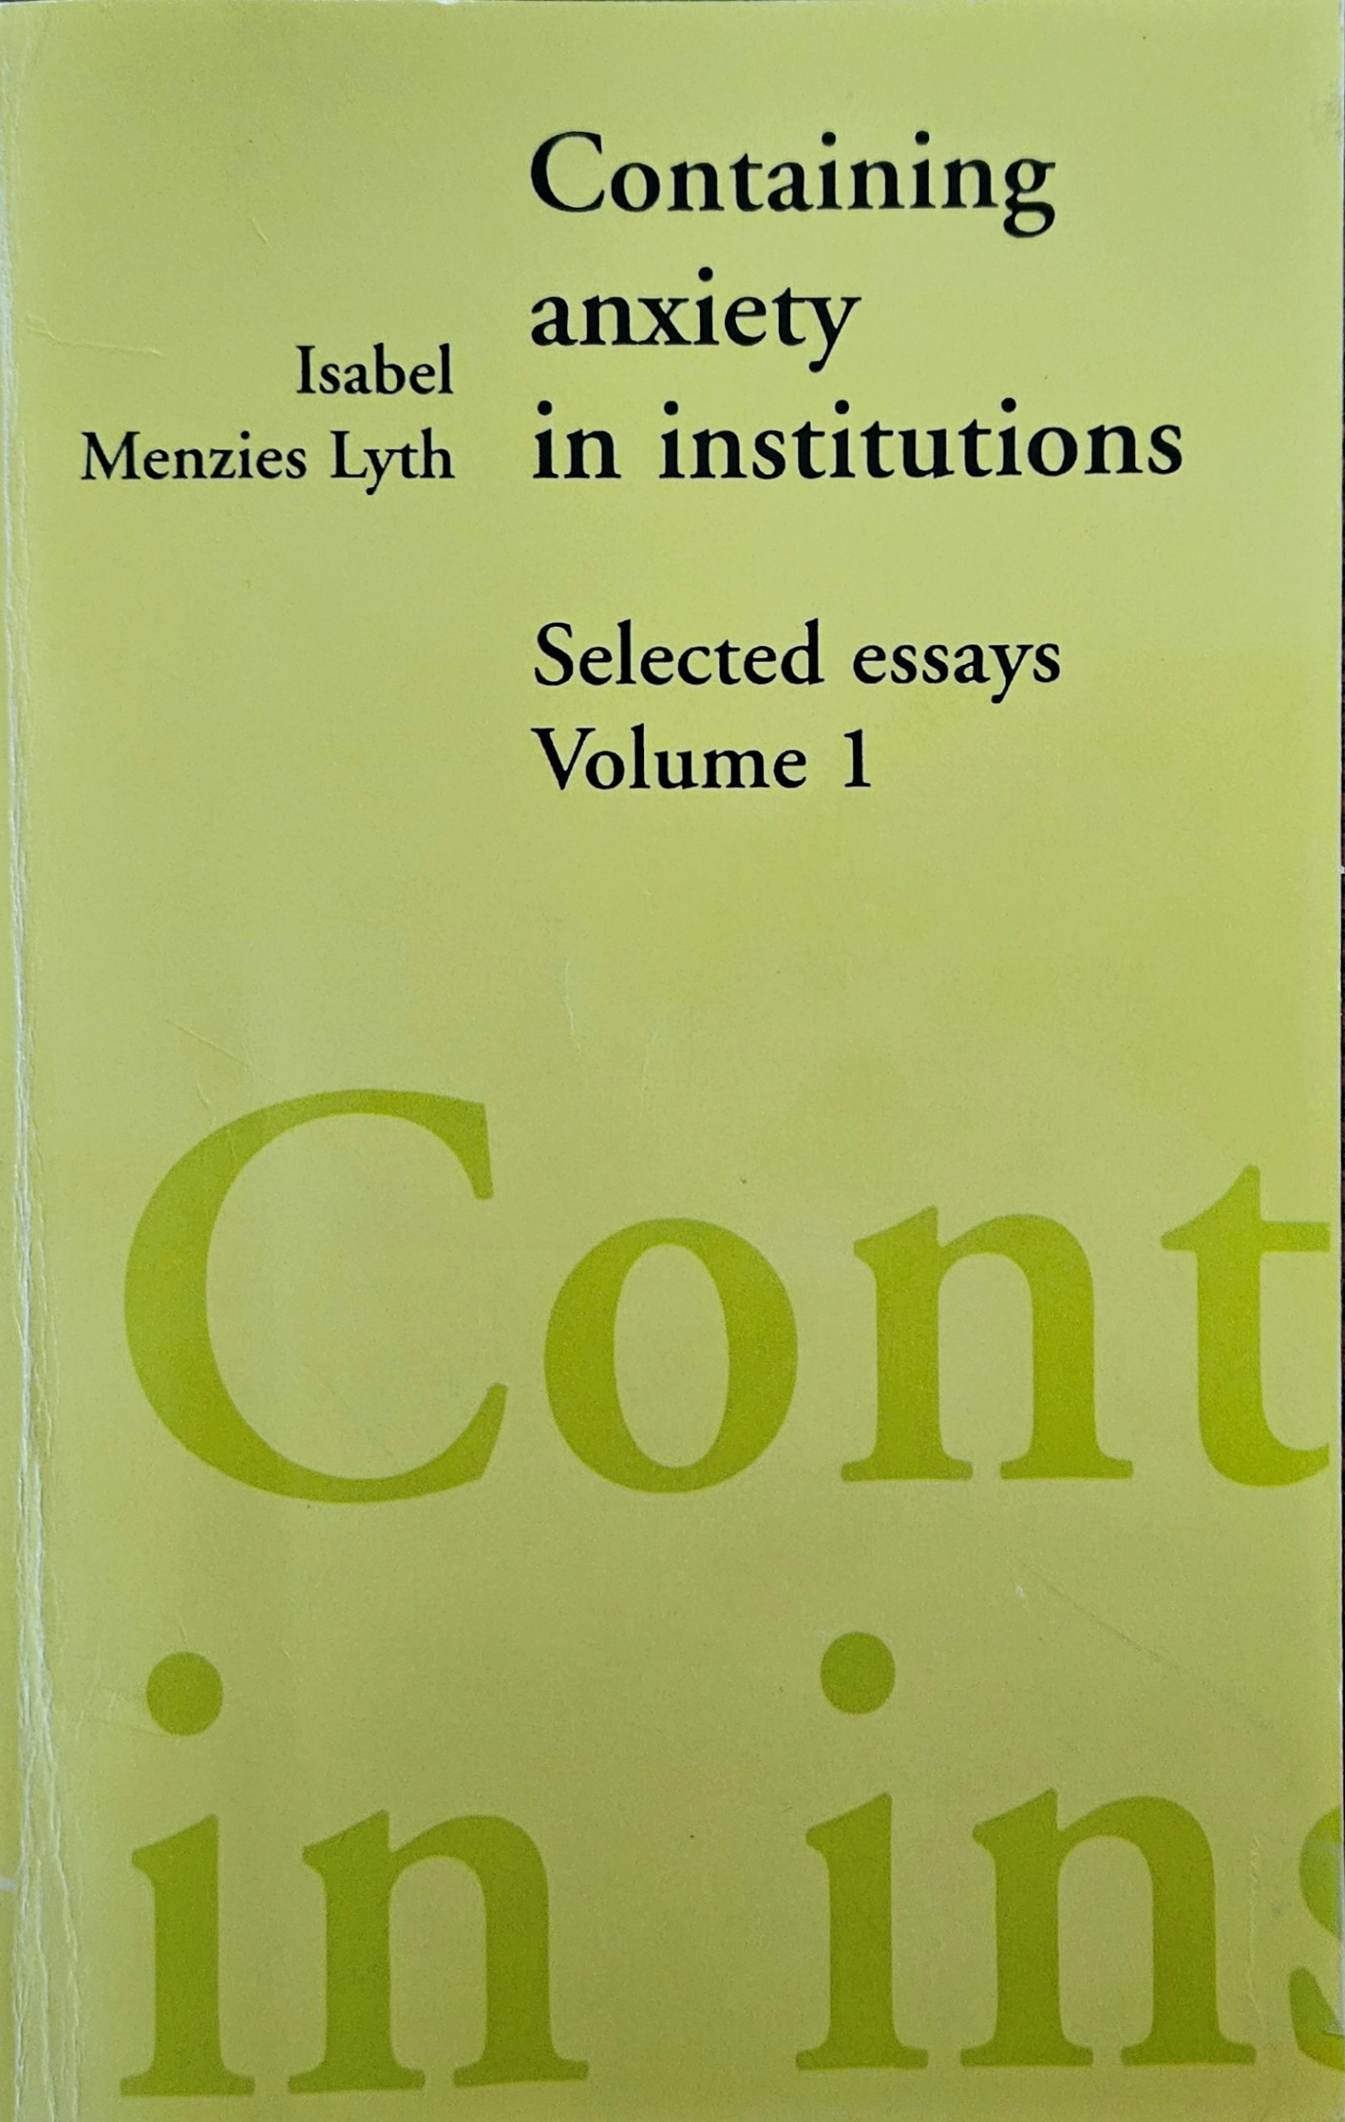
EFFECTIVE TASK PERFORMANCE & STAFF SUPPORT
Menzies Lyth makes the vital point that being enabled to carry out a task effectively is a crucial task of management and staff support.
People derive satisfaction from carrying out their work effectively, individually and as a team, in collaboration with others.

Slide 58
EFFECTIVE TASK PERFORMANCE & STAFF SUPPORT
Menzies Lyth refers to,
“… the satisfactions arising from being able to deploy oneself positively and fully in relation to task, co-operating effectively with others and experiencing both personal and institutional success in task-performance.

Slide 59
EFFECTIVE TASK PERFORMANCE & STAFF SUPPORT
… People require such satisfactions and their realization is an essential aspect of staff support.” (p.228)
She refers to,
“… the firm, authoritative management which is a necessary feature of both staff support and client therapy.” (p.230)

Slide 60
EFFECTIVE TASK PERFORMANCE & STAFF SUPPORT
Menzies Lyth concludes,
“This paper has stressed the importance of effective institutional management as a major factor in staff support. We have concentrated mainly on one particular aspect of management, that is its responsibility for effective task-performance.

Slide 61
EFFECTIVE TASK PERFORMANCE & STAFF SUPPORT
… Incidental mention only has been made of other aspects of good management that support staff, for example, clarification of roles, task and responsibility and the relationships involved in them, and the support arising from being given fully challenging tasks with the authority to carry them out.” (p.234)

Slide 62
EFFECTIVE TASK PERFORMANCE & STAFF SUPPORT
What Menzies Lyth says above about clarity of roles, responsibilities, and authority is vitally important.
It connects back to the points about micromanagement. It is counterproductive to give people responsibilities but not the appropriate space, autonomy, and authority to carry out their work.

Slide 63
EFFECTIVE TASK PERFORMANCE & STAFF SUPPORT
It can be argued that at the centre of staff support and the heart of well-being is effective task performance, facilitated by good quality leadership and management.
Poor worker well-being can be caused by poor task performance, leadership, and management.

Slide 64
EFFECTIVE TASK PERFORMANCE & STAFF SUPPORT
“Above all, such task-orientated activities facilitate the support given to staff through belonging to an institution that functions well and gives both the rewards for work well done and the rewarding relationships that go with them.” (p.235)

Slide 65
UNCERTAINTY,
DECISION-MAKING,
& JUDGEMENT

Slide 66
Uncertainty & Decision-Making
“The attempt to eliminate decisions by ritual task-performance. Making a decision implies making a choice between different possible course of action and committing oneself to one of them; the choice being made in the absence of full factual information about the effects of the choice. If the facts were fully known, no decisions, need be made; the proper course of action would be self-evident. …

Slide 67
Uncertainty & Decision-Making
… All decisions are thus necessarily attended by some uncertainty about their outcome and consequently by some conflict and anxiety, which will last until the outcome is known. The anxiety consequent on decision-making is likely to be acute if a decision affects the treatment and welfare of patients.” (Menzies Lyth, 1959, 1961, 1970, p.54-55)

Slide 68
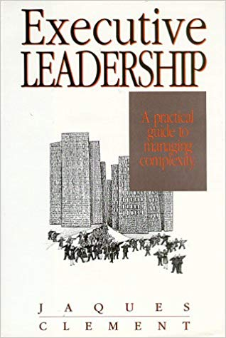
Uncertainty & Judgement
“Work is about pondering, wondering, uncertainty, choosing to do this rather than that at critical decision points, starting with choosing one pathway rather than another within the general method specified to be used, and continuing to use judgment in overcoming obstacles, until the goal is reached.” (Jaques and Clement, 1991)

Slide 69
EMOTIONAL INTELLIGENCE
& STRATEGIC INTELLIGENCE

Slide 70
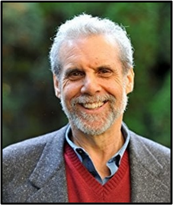
Emotional Intelligence
“The term, "emotional intelligence," was popularized in 1995 by psychologist and behavioral science journalist, Dr. Daniel Goleman, in his book, Emotional Intelligence. Dr. Goleman described emotional intelligence as a person's ability to manage their feelings so that those feelings are expressed appropriately and effectively. According to Goleman, emotional intelligence is the largest single predictor of success in the workplace.” (Cole, 2019)

Slide 71
Emotional Intelligence
Goleman (1995) outlined five components of emotional intelligence:
Self-awareness
Self-regulation
Motivation
Empathy
Social skills

Slide 72
Emotional Intelligence
Goleman (2008) succinctly states the importance of developing these abilities in organizations,
“About ten years of accumulated data from organizations of all kinds shows that there's a direct correlation between the emotional intelligence of leadership at every level and how that organization performs by whatever performance metric you want to use.”

Slide 73
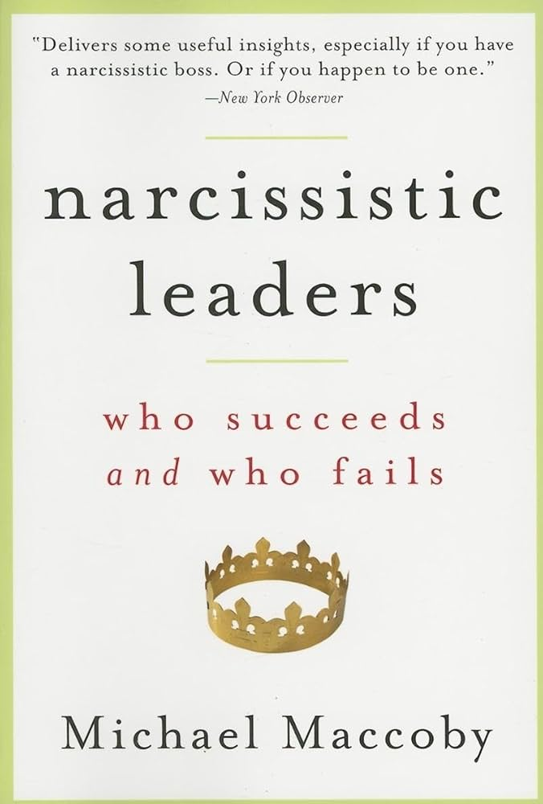
Strategic Intelligence
Michael Maccoby (2007, 2015b), who is recognized globally as a leadership expert, argues that in some leadership roles, what he calls strategic intelligence is even more important than emotional intelligence.
He explains (2007, p.156) that strategic intelligence consists of “five interrelated concepts or competencies” – foresight, systems thinking, visioning, motivating, and partnering.

Slide 74
Strategic Intelligence
Leaders with these qualities are often found in pioneering, groundbreaking organizations and industries.
They have a “different way of seeing the world, an ability to synthesize and integrate, to conceptualize the whole rather than a collection of separate parts” (2007, p.167). They may have the ability to see extremely complex patterns. They are alert to opportunities and threats.

Slide 75
Strategic Intelligence
Maccoby (2007, p.150) defines the style of these leaders as visionary, productive, and narcissistic. The key point is whether they are productive or not, in a way that provides a benefit to others. He argues that many of them,
“… have built highly successful and sustained businesses, (and) you’ll find that they score very low on emotional intelligence”.

Slide 76
Strategic Intelligence
Such leaders are often not especially self-aware, reflective, sensitive, or empathetic. He continues (2007, p.154),
“… that the model of an empathetic leader is not necessarily suited to head up a competitive, change-orientated industry.”

Slide 77
ORGANIZATIONAL SYSTEM
DYNAMICS & LEADERSHIP

Slide 78
“In view of these severe organizational difficulties, the present-day tendency to see organizational problems in terms of psychologically determined personality conflicts is most unfortunate, because it obscures the organizational sources of most conflict, pointing the finger at individuals rather than at the organizational morass that lies at the heart of the problem…

Slide 79
… A useful principle is that no difficulties arising between individuals in these organizations are to be seen as arising from personality difficulties, unless and until it has been clearly established that the organizational context is requisite!” (Jaques and Clement, 1991, p.43)

Slide 80
“Our view is that far too much emphasis is being placed upon personality make-up these days, and that far too many of the problems of management and of managerial leadership are being seen in terms of interpersonal relationships and interpersonal conflict. It is impossible to tell how much an apparent interpersonal conflict is the result of a clash of personality or of inadequate managerial organization. In the vast majority of cases, it is the latter…

Slide 81
… A good rule of thumb to use is that, until and unless a requisite organization has been established, it is fair to assume that interpersonal stresses and strains and inadequate managerial leadership are the products of poor organization rather than personality problems. “Cherchez l’organisation” every time.” (p.xxv)

Slide 82
REFERENCES

Slide 83
REFERENCES
Argyris, C. (1991) Teaching Smart People How to Learn, in, Harvard Business Review, May-June 1991
https://hbr.org/1991/05/teaching-smart-people-how-to-learn
Barton, S., Gonzalez, R. and Tomlinson, P. (2012) Therapeutic Residential Care for Children: An Attachment and Trauma-informed Model for Practice, London and Philadelphia: Jessica Kingsley Publishers
Brene Brown - Boundaries (2021) https://www.youtube.com/watch?v=-WpdsRPzKco
Cole, B. (2019) Emotional Intelligence (EI): Definition, TechTarget https://www.techtarget.com/searchcio/definition/emotional-intelligence#:~:text=The%20term%20emotional%20intelligence%20was,are%20expressed%20appropriately%20and%20effectively
Dewey, J. (1910) How We Think, Boston, New York, Chicago: D. C. Heath & Co
Friedman, E.H. (1999) A Failure of Nerve: Leadership in the Age of the Quick Fix, New York: Church Publishing, Inc.
Goleman, D. (1995) Emotional intelligence, New York: Bantam Books, Inc.
Goleman, D. (2008) Social Intelligence and Leadership
https://www.youtube.com/watch?v=7Qv0o1oh9f4

Slide 84
REFERENCES
Jaques, E. and Clement, S.D. (1991) Executive Leadership: A Practical Guide to Managing Complexity, Basil Blackwell: Cason Hall and Co. Publishers
Maccoby, M. (2007) Narcissistic Leaders: Who Succeeds and Who Fails, Boston, Massachusetts: Harvard Business School Press
Maccoby, M. (2015) World Affairs Councils of America, 2015 Annual Conference, Washington DC
November 11th – Keynote Discussion: Developing Global Leadership
https://www.youtube.com/watch?v=LL7kvKKO-9Y&t=2769s
Maccoby, M. (2015b) Strategic Intelligence: Conceptual Tools for Leading Change, Oxford, UK: Oxford University Press
Marquet, L.D. (2012) Turn the Ship Around! A True Story of Turning Followers into Leaders, Penguin Group: New York, USA
Mattis, J. (2003) General James Mattis, on the Matter of Professional Military Reading,
https://thearmyleader.co.uk/mattis-professional-military-reading/

Slide 85
REFERENCES
Menzies Lyth, I. (1959, 1961, 1970) The Functioning of Social Systems as a Defence Against Anxiety, in, Containing Anxiety in Institutions: Selected Essays (1988) Vol. 1, London: Free Association Books
Menzies Lyth, I. (1979) Staff Support Systems: Task and Anti-Task in Adolescent Institutions, in, Containing Anxiety in Institutions: Selected Essays, Vol. 1. London: Free Association Books (1988), https://www.johnwhitwell.co.uk/child-care-general-archive/task-and-anti-task-in-adolescent-institutions/
Menzies Lyth, I. (1985) The Development of the Self in Children in Institutions, in, Containing Anxiety in Institutions: Selected Essays, Vol. 1. London: Free Association Books (1988), https://www.johnwhitwell.co.uk/child-care-general-archive/the-development-of-self-in-children-in-institutions/
Olson, J. (2013) The Slight Edge: Turning Simple Discipline into Massive Success & Happiness, Austin, Texas: Greenleaf Book Group Press
Senge, P.M. (1990) The Fifth Discipline: The Art and Practice of the Learning Organization, Currency, Random House
Tomlinson, P. (2021) What is Important in Leadership of Trauma Services, in, Treisman, K. (2021) A Treasure Box for Creating Trauma-Informed Organizations: Volumes 1 & 2, Vol. 2, p.64-67, Jessica Kingsley Publishers: London
Ulrich, D. (1998) Delivering Results: A New Mandate for Human Resource Professionals, Boston: Harvard Business School Press

